Slide 1
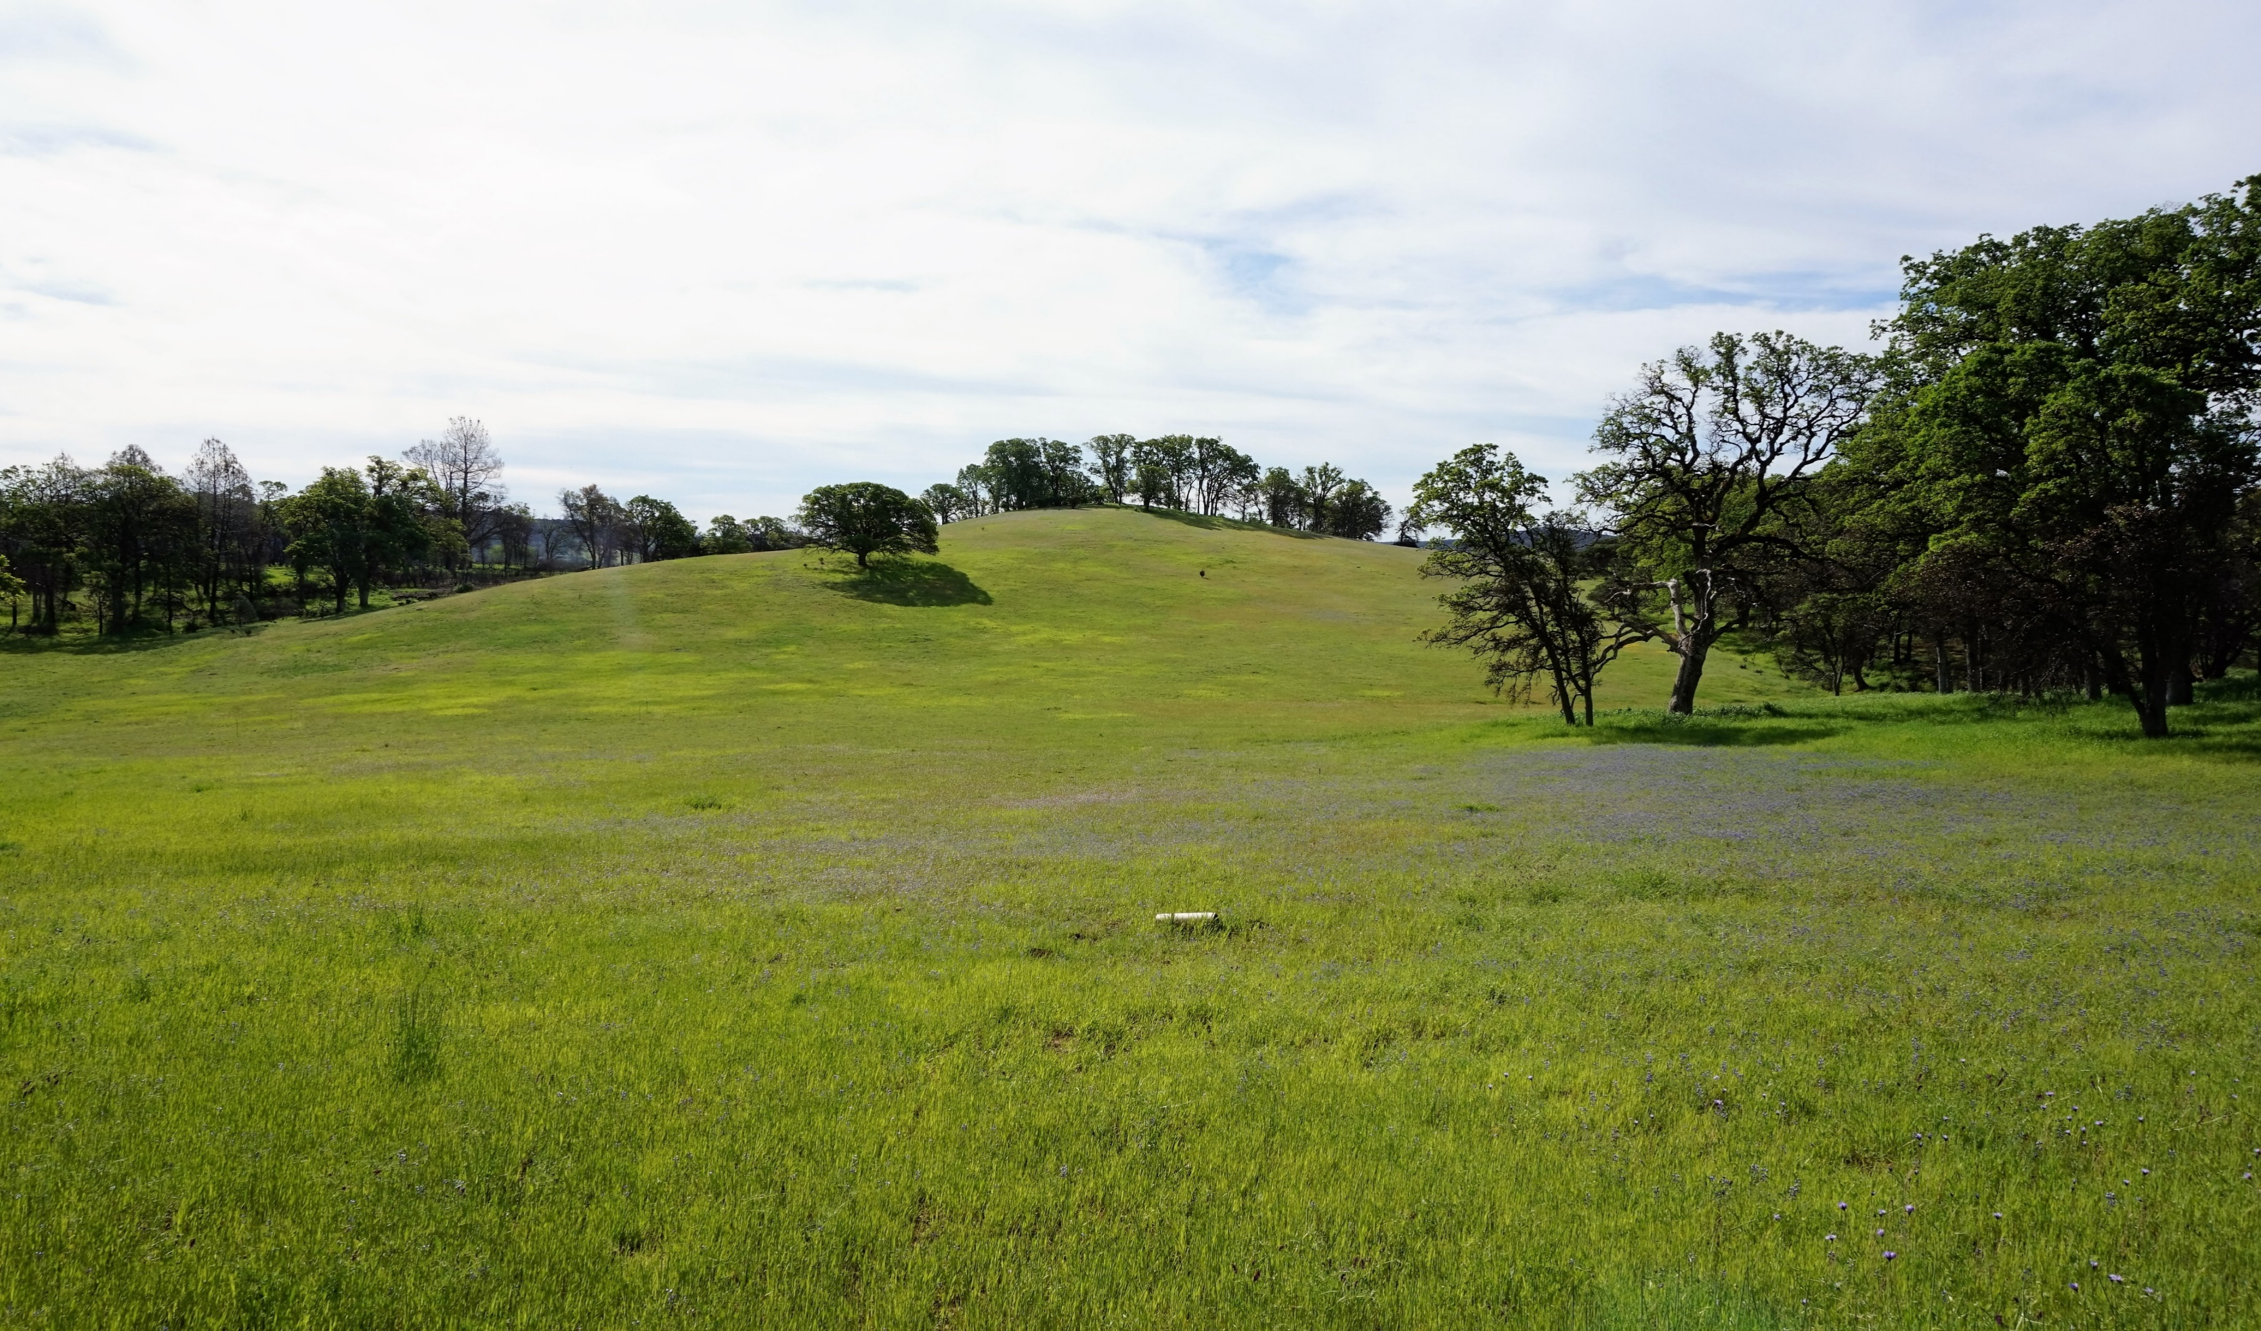
Nitrogen enrichment effects on grassland plant diversity are dependent on spatial scale
Evan Batzer and Valerie Eviner
University of California, Davis
COS 54 - Biodiversity II
8/8/2018

Slide 2
Introduction
Nitrogen enrichment is widely recognized as a driver of global biodiversity loss
Alters patterns of resource limitation that increases productivity and often produces a shift in limiting resources from nitrogen to light
May also reduce community biodiversity through environmental homogenization that limits opportunity for spatial coexistence
Ability to detect this change depends on the spatial scale of sampling
Sala et al. (2000) Science
Notes:
Nitrogen enrichment is a major threat to biodiversity worldwide.
Changes to biogeochemical cycling through atmospheric deposition, fertilizer runoff, and land use change
N enrichment increases plant productivity, reducing the number of light sensitive species and presenting fewer opportunities coexistence.
N enrichment may also reduce spatial heterogeneity in limiting resources, reducing the number of opportunities for spatial coexistence.
Increasingly, we understand that our ability to detect these changes depends on the spatial scale of sampling

Slide 3
Scale Dependence
Constant Effect
Diversity
Control
Concerns of scale are persistent in ecology (Levin 1992)
Many experiments conducted at small spatial scales (1m² or less)
More nuanced insights may come from cross-scale analysis
Scale-dependent variation in effects
Relationship between species richness and relative abundance
Treatment-driven changes in spatial pattern of biodiversity
Treatment
Effect Diminishes With Scale
Diversity
Control
Treatment
Inverted Effects
Diversity
Control
Treatment
No. Samples
Notes:
Concerns of scale are persistent in ecology, and recent scholarship has suggested that the impacts of human-induced environmental changes may depend on the extent of sampling.
Effects may stay constant, change in magnitude, or even invert depending on the scale sampled.
However, much of our understanding of how nitrogen enrichment impacts plant diversity comes from relatively small-scale experiments that evaluate change in a limited spatial context, often 1m² or less.
Evaluating these scale dependent relationships can give nuanced insights into the mechanisms of N-driven biodiversity change, particularly related to changes in species richness, abundance, and spatial pattern.

Slide 4
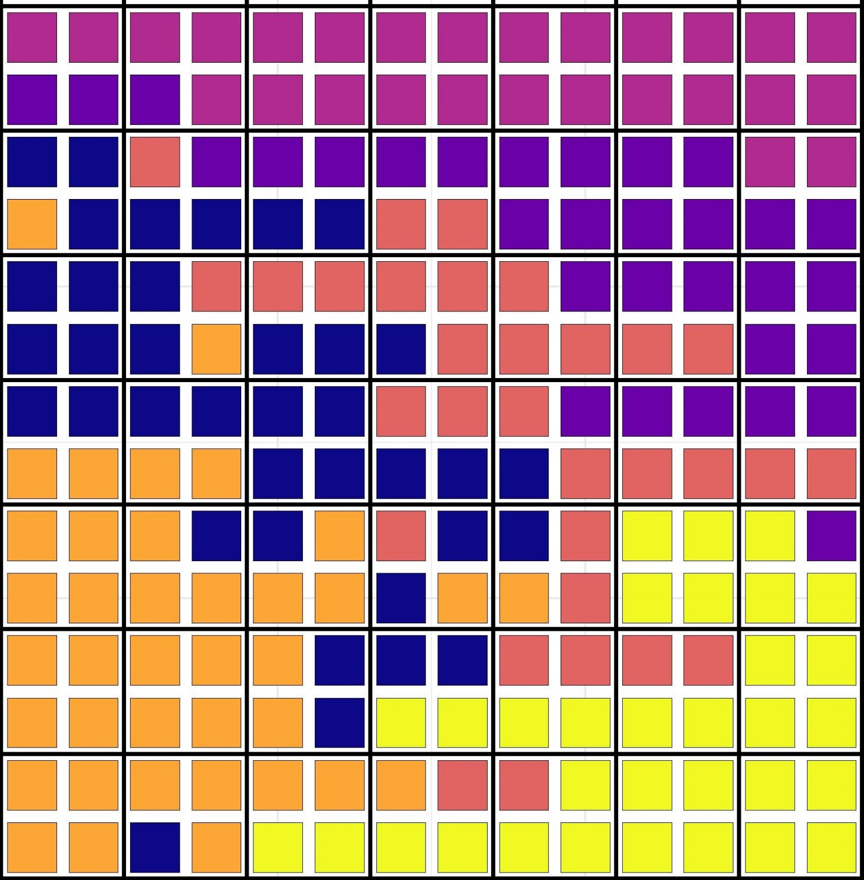

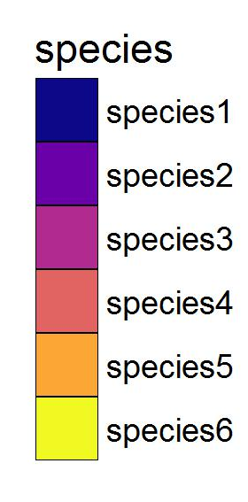
Example: N enrichment affects both diversity and spatial pattern
Control
N_{species} = 6
Higher spatial aggregation
Treatment
N_{species} = 4
Lower spatial aggregation
Notes:
To understand how cross-scale analysis can provide insight into these effects…
Control community contains 6 species, a nitrogen enriched community contains just 4.
In response to nutrient enrichment, this community also exhibits a more random spatial pattern.

Slide 5

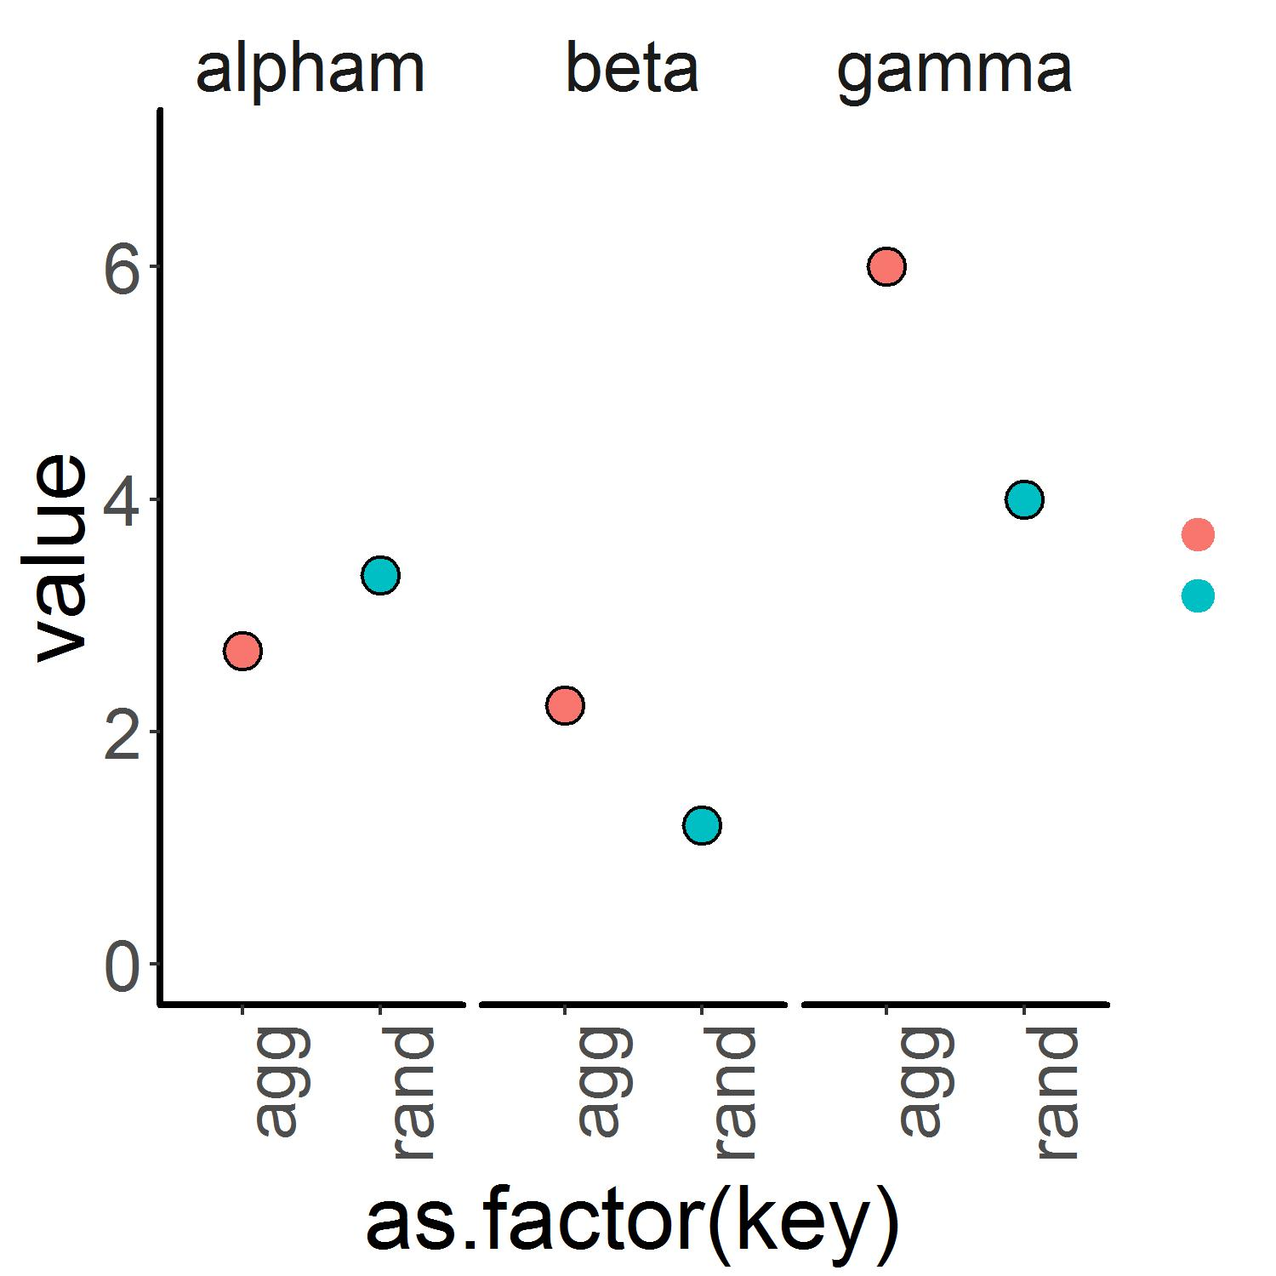



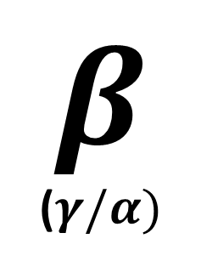
Assessing scale dependent effects
1
Species Richness
Control
+Nitrogen
2
$$α$$
$$γ$$
$$β$$
($γ/α)$
Notes:
Classically, we could evaluate this change using a single sampling scale – picking some subplot area and taking a measure of average alpha diversity values. In this case, we would detect relatively little difference in our communities.
We could also incorporate a measure of the entire sampled community into our analysis – constructing a value of gamma diversity between the two communities. Here, we detect substantial decline in response to treatment.
Taking the ratio of these two measures can also give us a sense of community turnover, or beta diversity. If our effects diverge at different scales, we can attribute this to a change in patterns of turnover in species identity or composition.

Slide 6
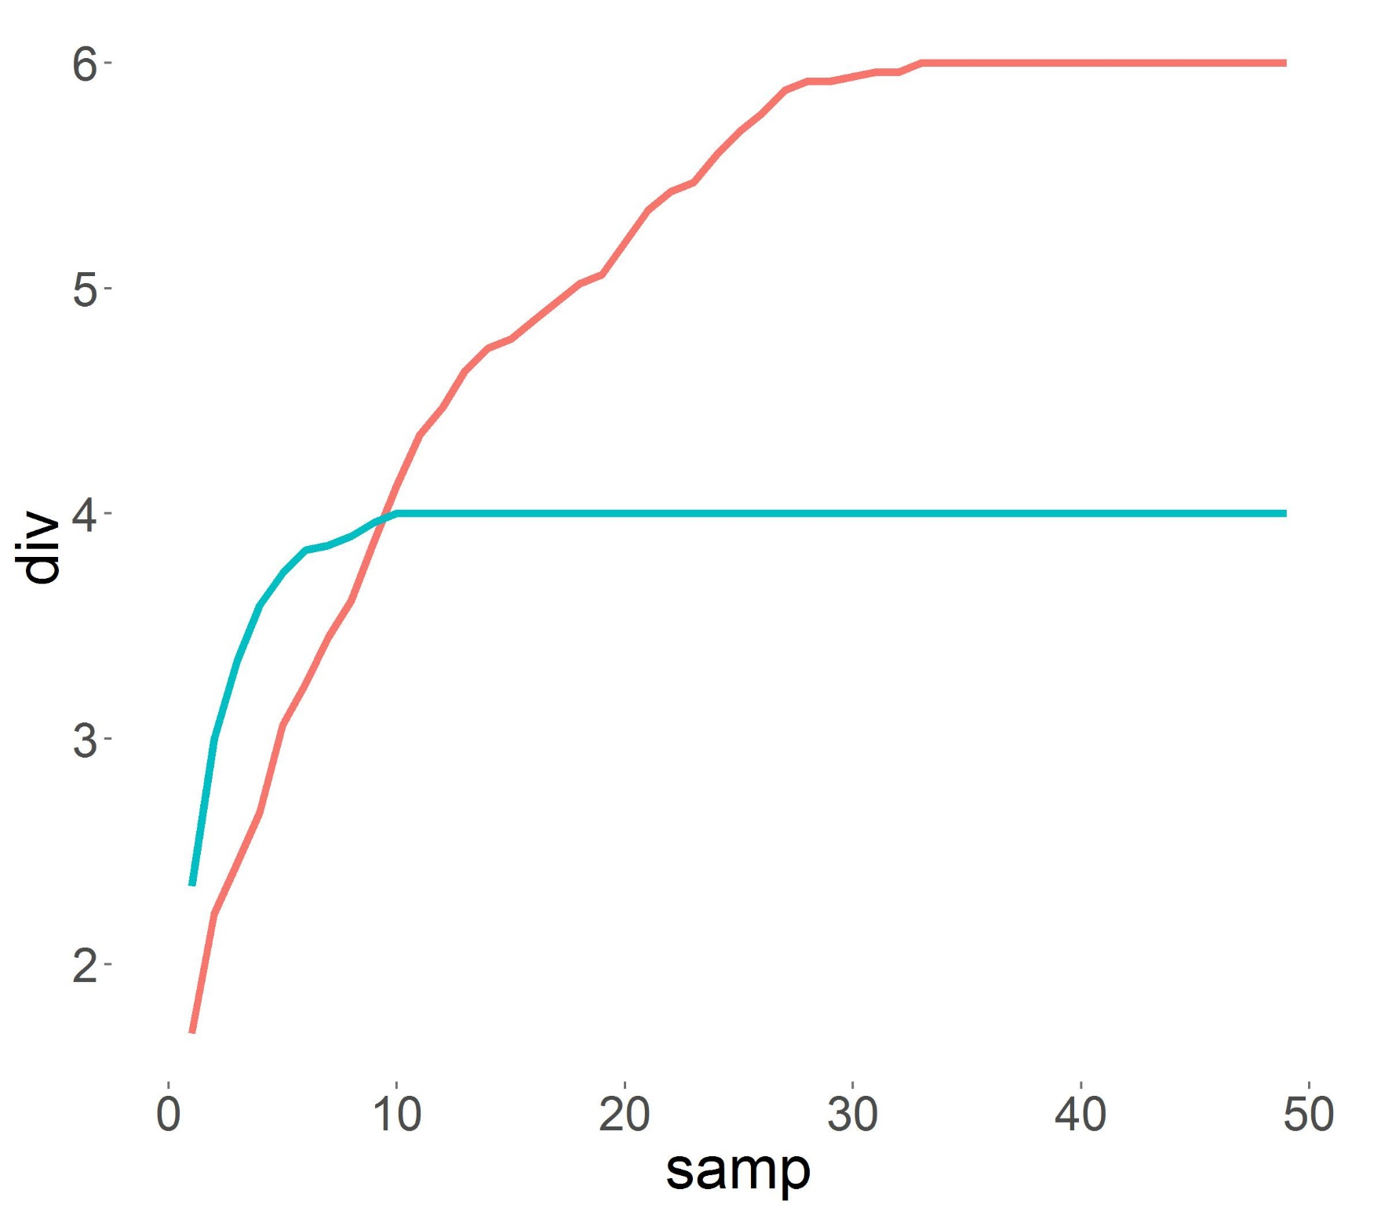
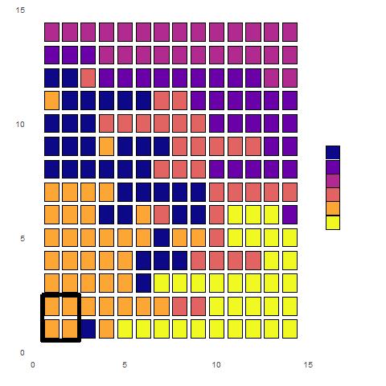
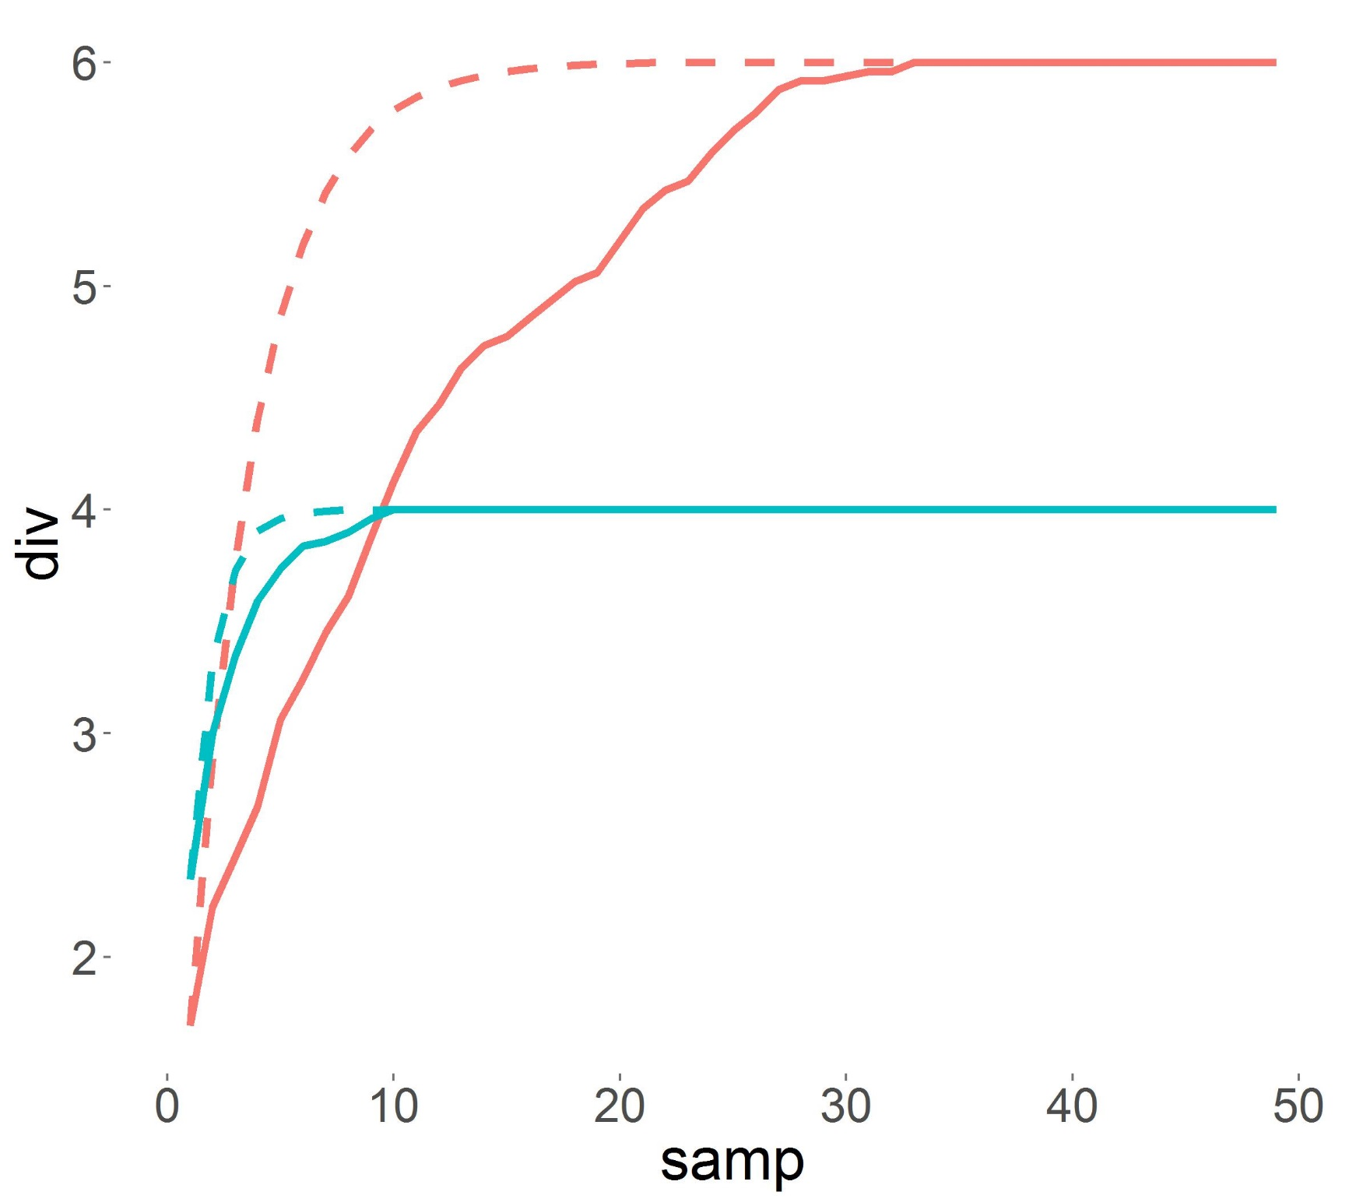
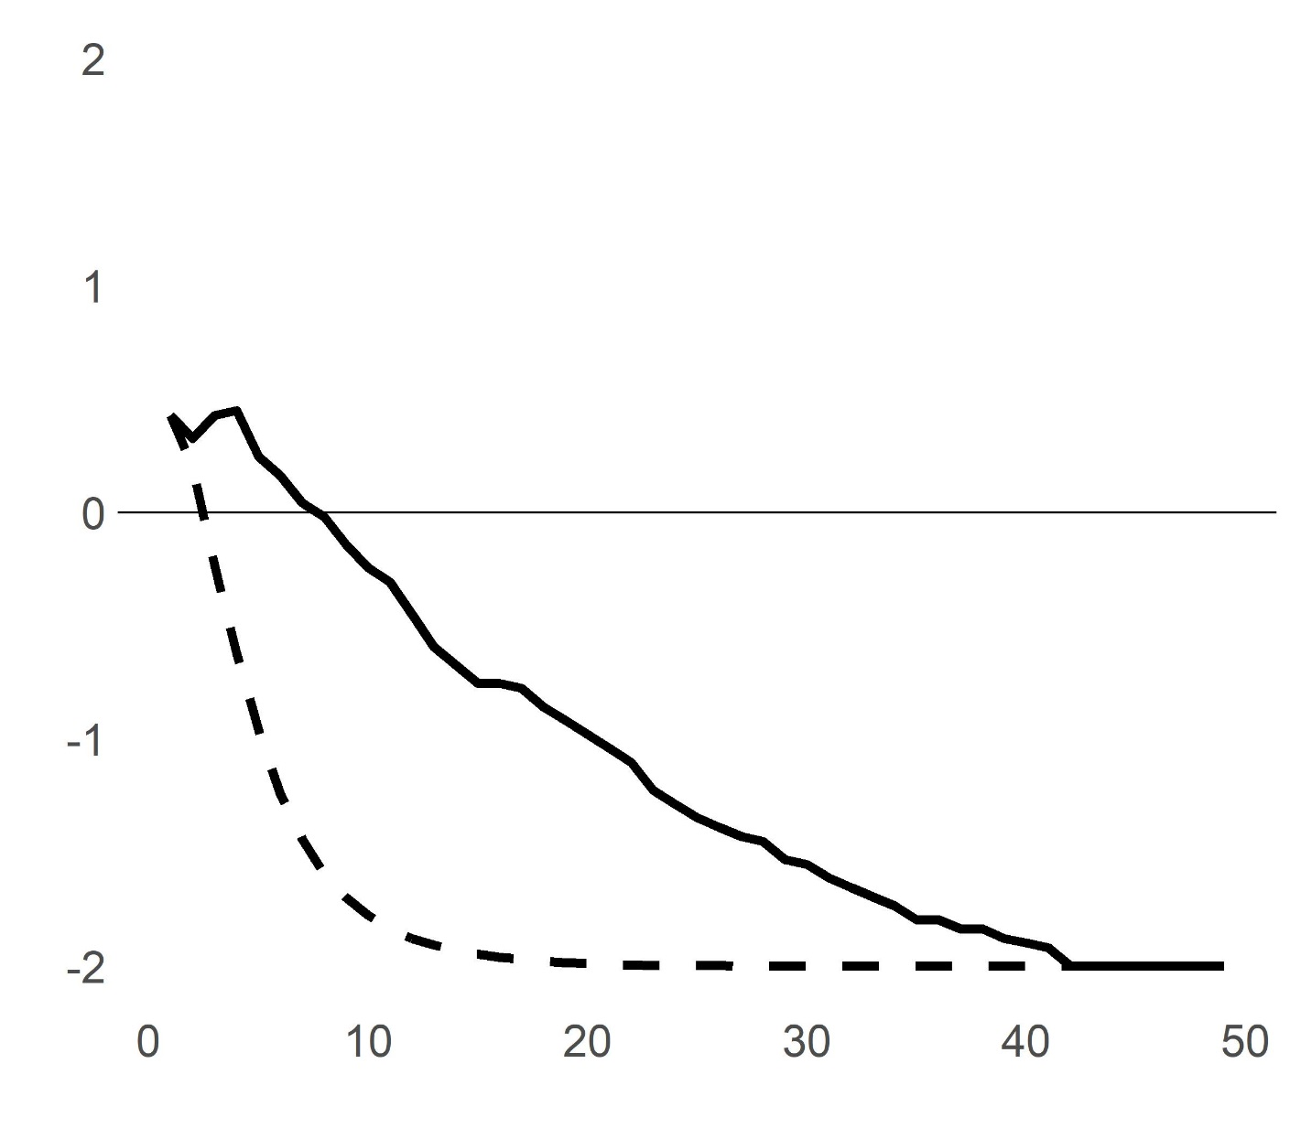
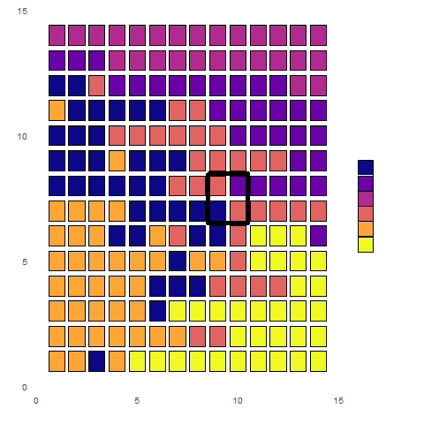
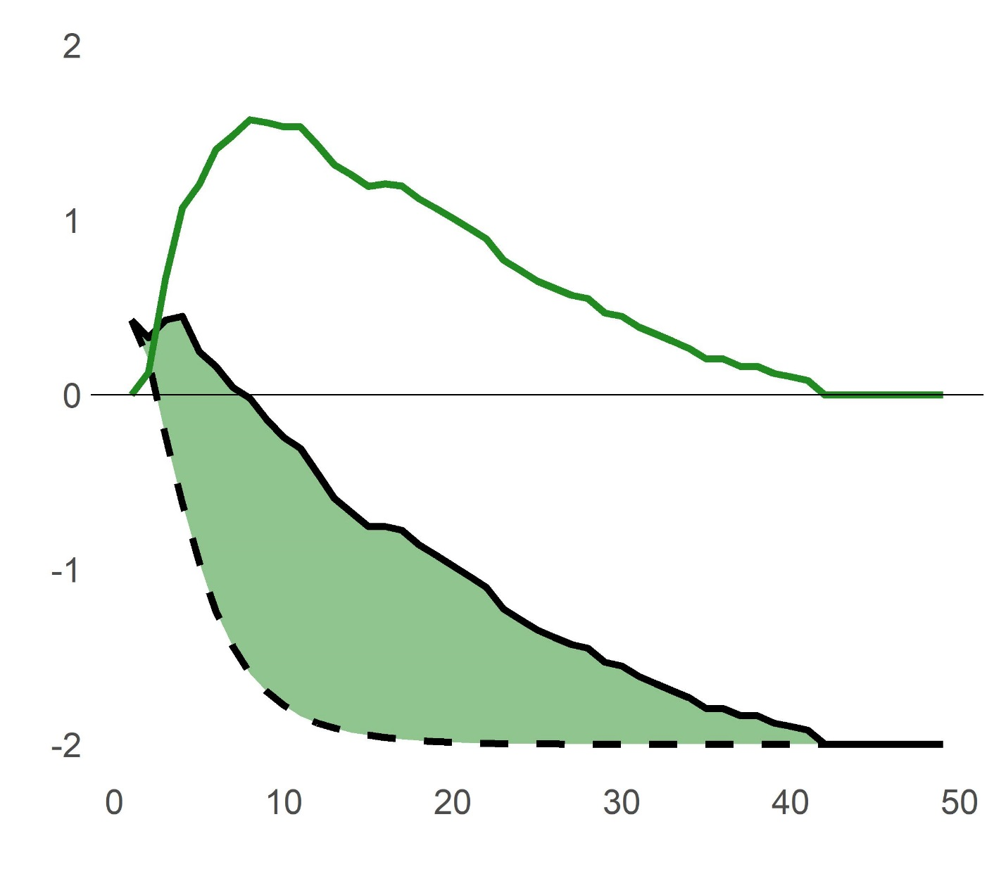
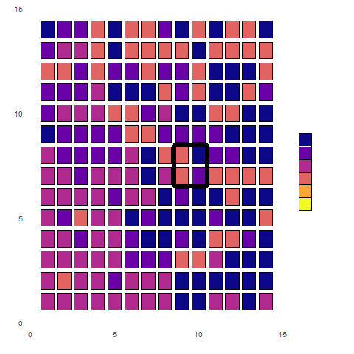
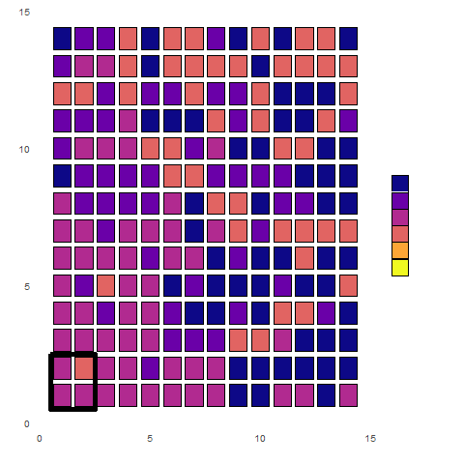
Quantifying change in spatial patterns
Control (1)
Aggregation effect
1
Net Diversity Change
Species Richness
+ Nitrogen (2)
Spatial rarefaction
Random rarefaction
Spatial rarefaction
Random rarefaction
Number of Samples
Number of Samples
Decomposition of scale-dependent relationships through:
Explicit (spatially ordered) rarefaction
Random rarefaction
Aggregation effect
2
Notes:
- However, this sort of analysis only gives us information on two coarse sampling scales. More nuanced information can come from decomposition of these relationships into sample-based rarefaction curves.
One method in doing so is to construct spatially-explicit sample curves, where diversity measures are accumulated by always including new samples based on proximity to some starting point. Doing so allows us to examine how diversity is encountered in the system and where threshold points of change exist in sampling.
Here, we see that our observed difference in communities is nonlinear, and there’s a threshold sample size where interpretation of change flips.
To understand how spatial patterns structure this interpretation, we can also accumulate samples at random. This nonspatial rarefaction will generate two separate curves that ignore spatial patterns.
If communities exhibit more spatial aggregation (clumping), we’ll see that this random accumulation will be much more rapid than it’s spatially structured counterpart.
Comparing observed differences between spatial and nonspatial curves can be used to quantify aggregation – in this case, our observed diversity change is more negative with random rarefaction, indicating that our communities become more spatially random with treatment.
For rarefaction, we can use pure species richness (as in this example, or any other scale-invariant metric, such as the inverse simpson index) to contrast effects when purely focusing on either richness or relative abundance.

Slide 7
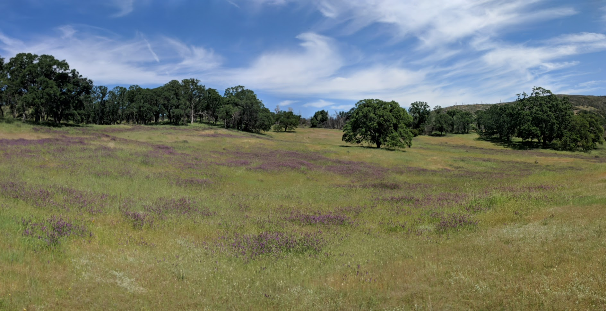
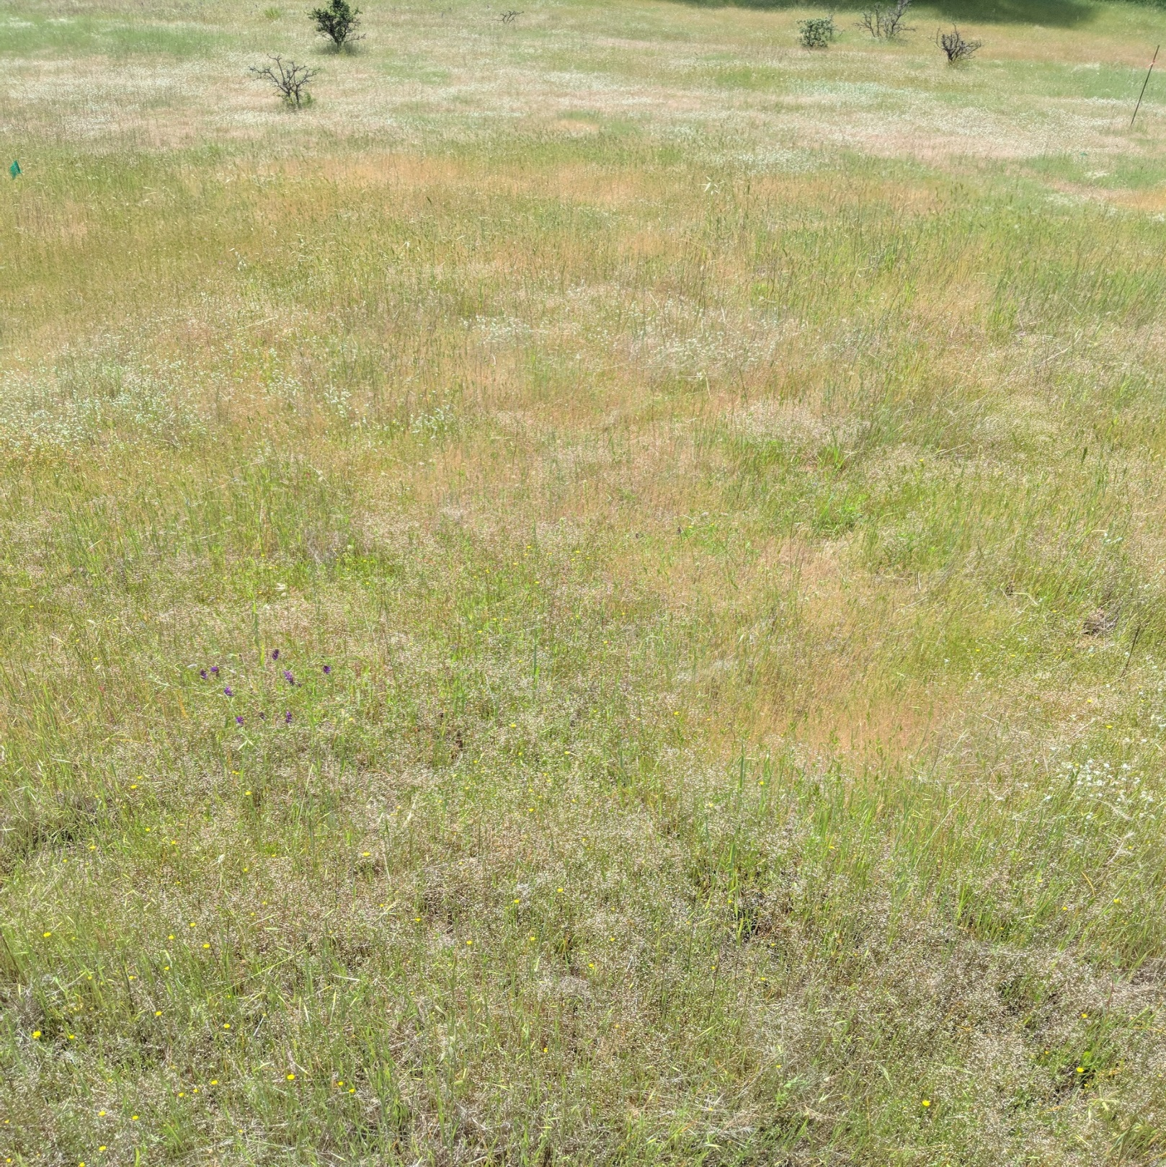
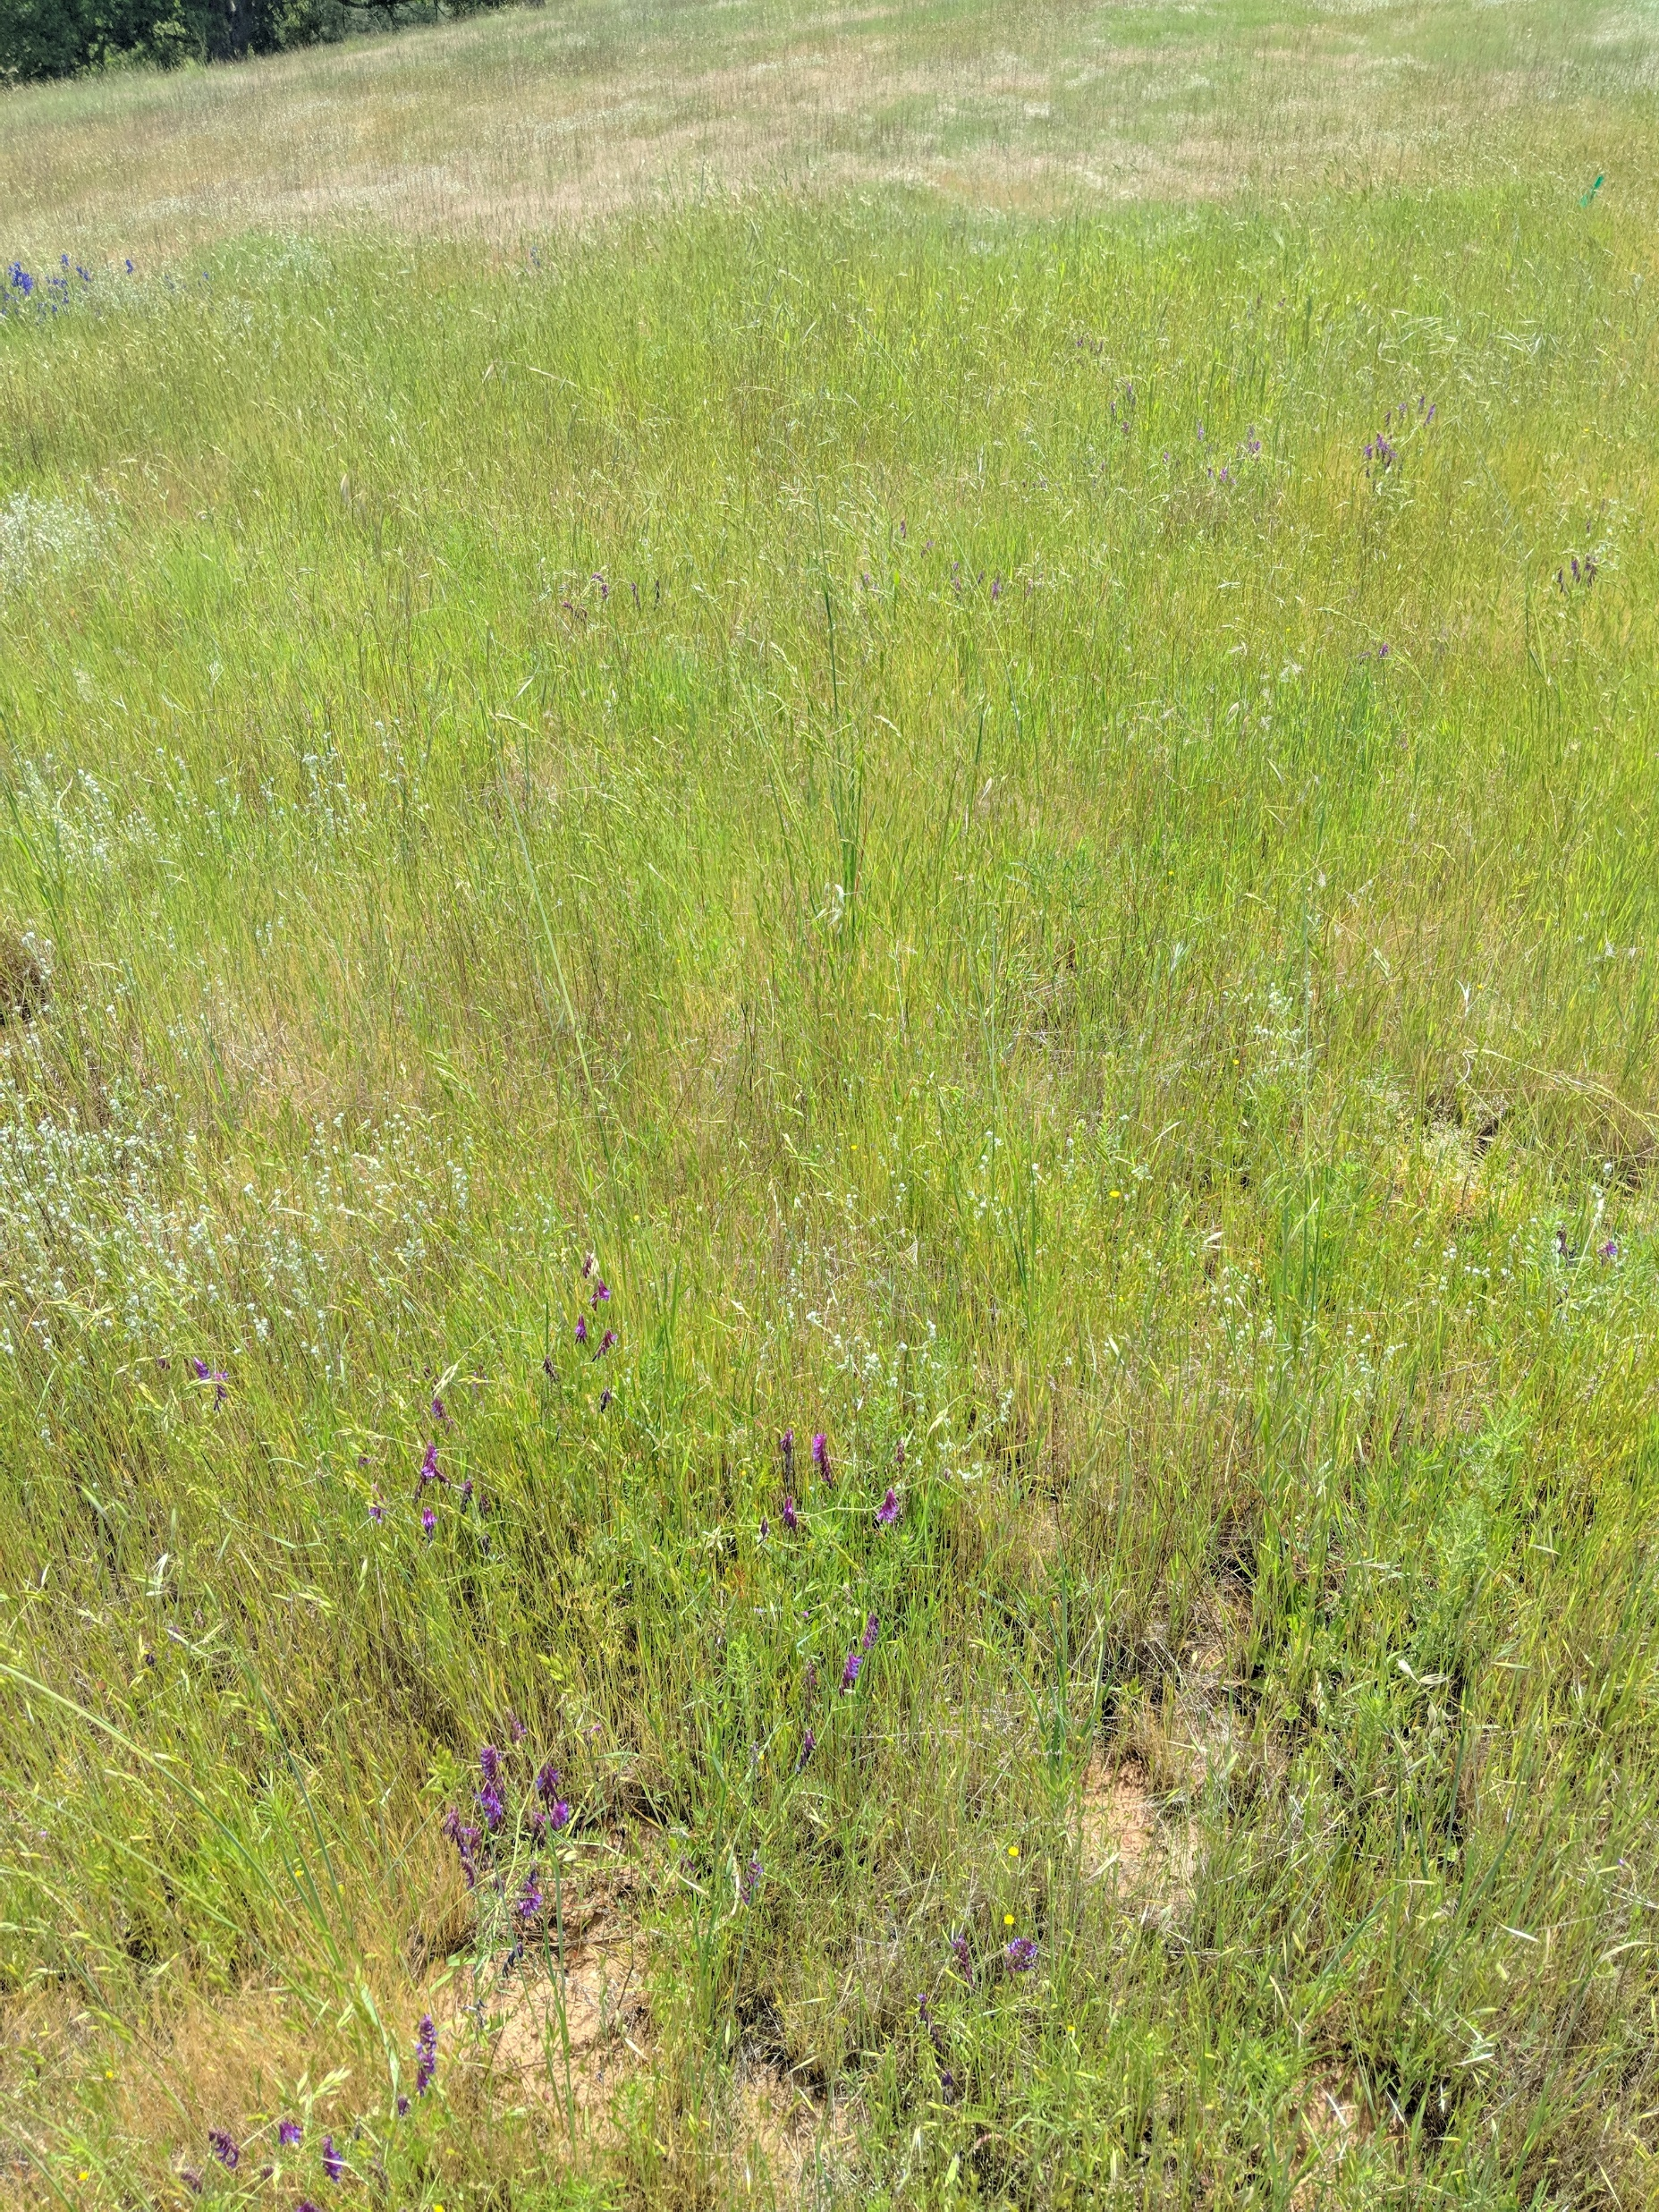
California Annual Grasslands
Control
+ Nitrogen
Notes:
California grasslands are an ideal system within which to examine the drivers of scale-dependent relationships in response to nitrogen enrichment.
Highly spatially heterogenous, California grasslands exhibit very high diversity despite their exotic diversity – 10 or more species per square meter.
Current understanding often suggests that fertilization enhances the growth of exotic grasses at the expense of native forb and legume species.

Slide 8
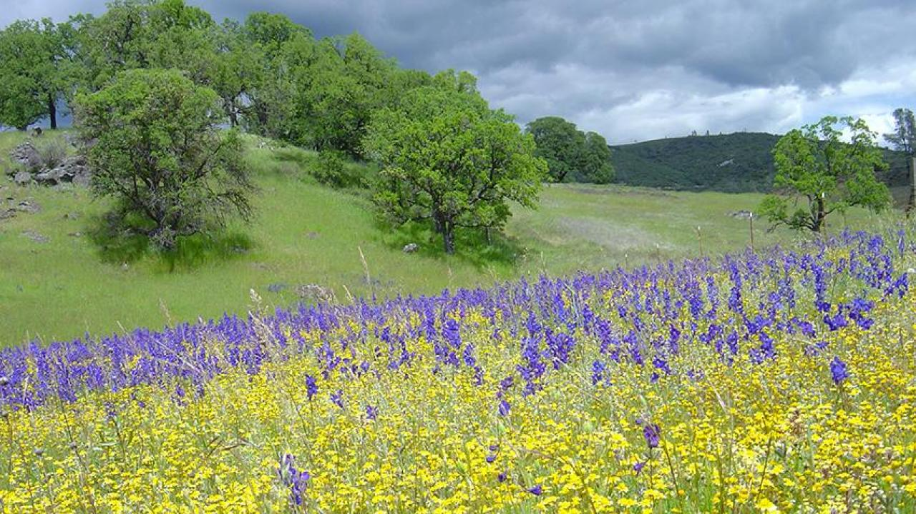
f
Questions
How do choices of sampling scale affect our interpretation of nitrogen driven biodiversity change?
How do scale-effect relationships vary with use of species richness or abundance-weighted diversity metrics?
Does N enrichment have a spatially homogenizing effect on diversity?
Notes:
Using this framework, we asked a set of questions:
How do choices of sampling scale affect our interpretation of nitrogen-driven biodiversity change?
Do effects increase, decrease, or stay with same as a function of spatial scale?
2. To what degree is the scale-effect relationship dependent on changes in species richness and relative abundance?
1. Are these changes primarily mediated by loss of species from the system, or changes in their relative abundance that interact with sampling effects.
3. Does N enrichment have a spatially homogenizing effect on diversity?
Is potential loss in relevant nitrogen variation in soil a driver of observed biodiversity patterns?

Slide 9
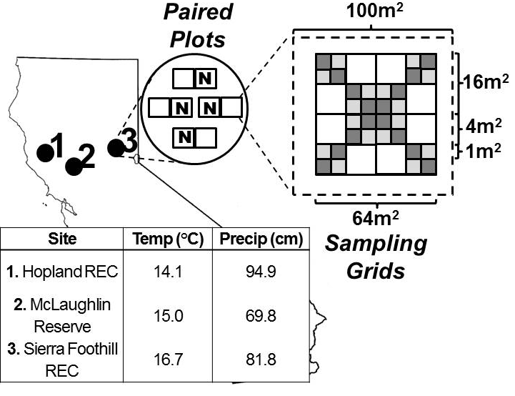
Study Design
3 Sites
4 blocks per site (12 blocks total)
2 paired plots per block (24 plots total)
Plot area 100m² (10m x 10m)
64 sampling subplots per block
Subplot area .25m² (.5m x .5m)
1m interval between subplots
Sampling extent 64m² (8m x 8m)
Fertilization treatment
Randomly assigned to 1 plot per block
Slow-release urea fertilizer, 10g N/m²
Applied in January – February 2017, 2018
Notes:
To assess scale-dependent patterns of nitrogen enrichment effect on plant diversity, we established a nested plot experiment at three University of California reserves.
In each reserve we established 4 blocks, each consisting of 2 paired plots
Each subplot was then divided into an 8x8 grid containing .5m x .5m subplots spaced every 1m.
We then randomly assigned one plot out of each pair to an experimental fertilization treatment, consisting of a slow-release urea fertilizer applied at a rate of 10g N/m² in winter months.

Slide 10
Responses Measured
Richness and Composition
Visual estimates of areal plant cover at three phenological timepoints in each plot
Light Interception
10 random locations within each plot
Photosynthetically Active Radiation (PAR) measured above and below grass “canopy”
Biomass
10 random locations within each plot
10cm x 100cm collection of all aboveground biomass
Notes:
- We then collected data on three response variables:
- The first, community diversity and percent areal cover, was collected in all subplots at three times in each year, corresponding to peak phenological periods to ensure that all representative species were sampled.
- Light was measured using a 10-cell PAR sensor placed above and below the grass canopy in 10 random locations within each plot.
- We also measured changes in plant productivity using clipped strips of aboveground biomass in the margins between individual subplots.

Slide 11
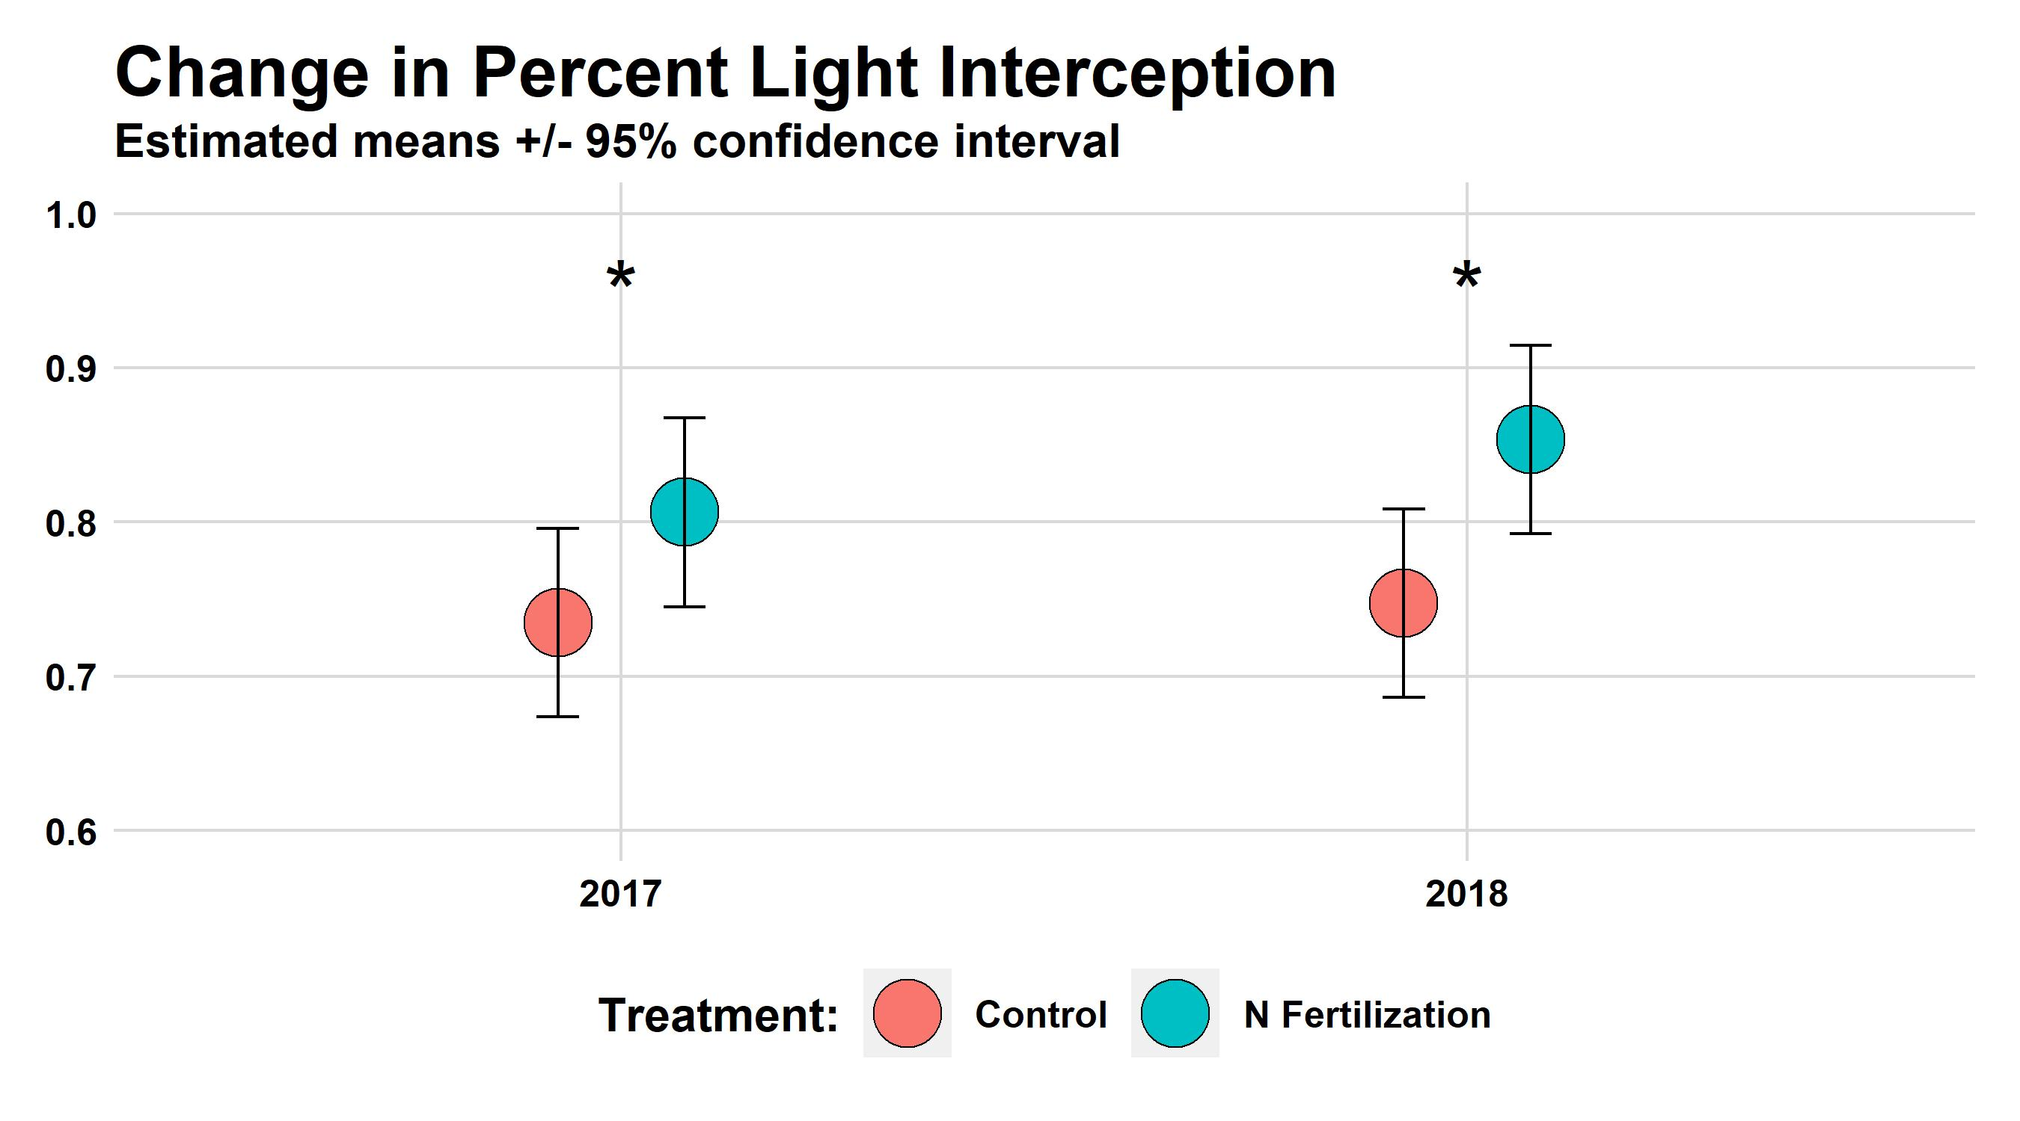
Proportion Light Intercepted
Notes:
Consistent with prior studies of nutrient enrichment, nitrogen addition produced significant increases the amount of light interception in both years, indicating an increased demand for light as a limiting resource.

Slide 12
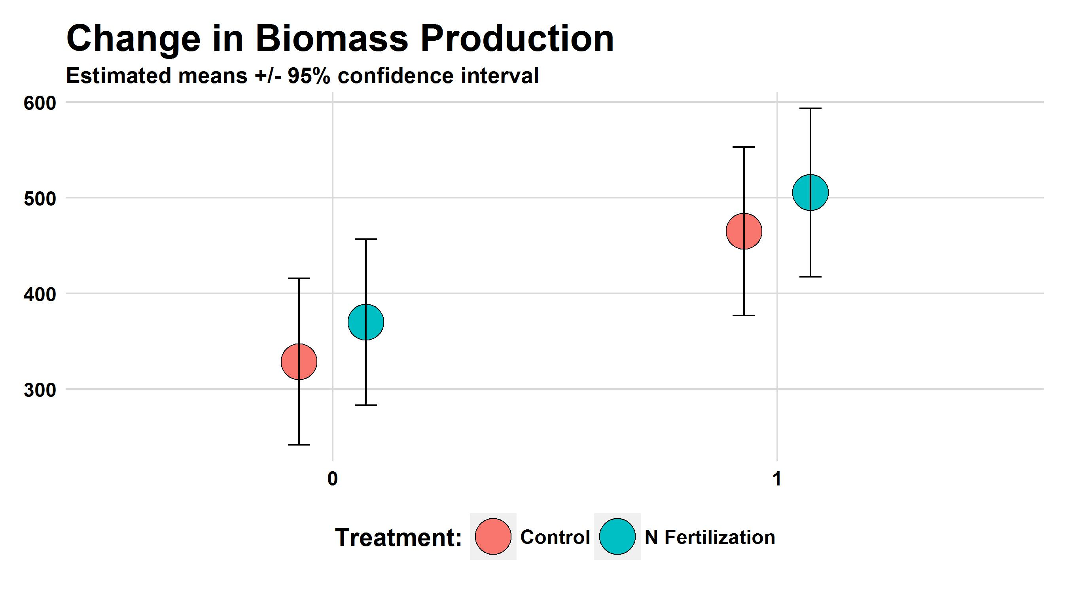
Productivity (g / m²)
2017
2018
Notes:
Commensurate with an increase in light limitation is an increase in plant productivity. While there was a trend towards increased biomass in response to treatment, we didn’t find significant results in our first two years of sampling, perhaps due to the variability of these measures.

Slide 13
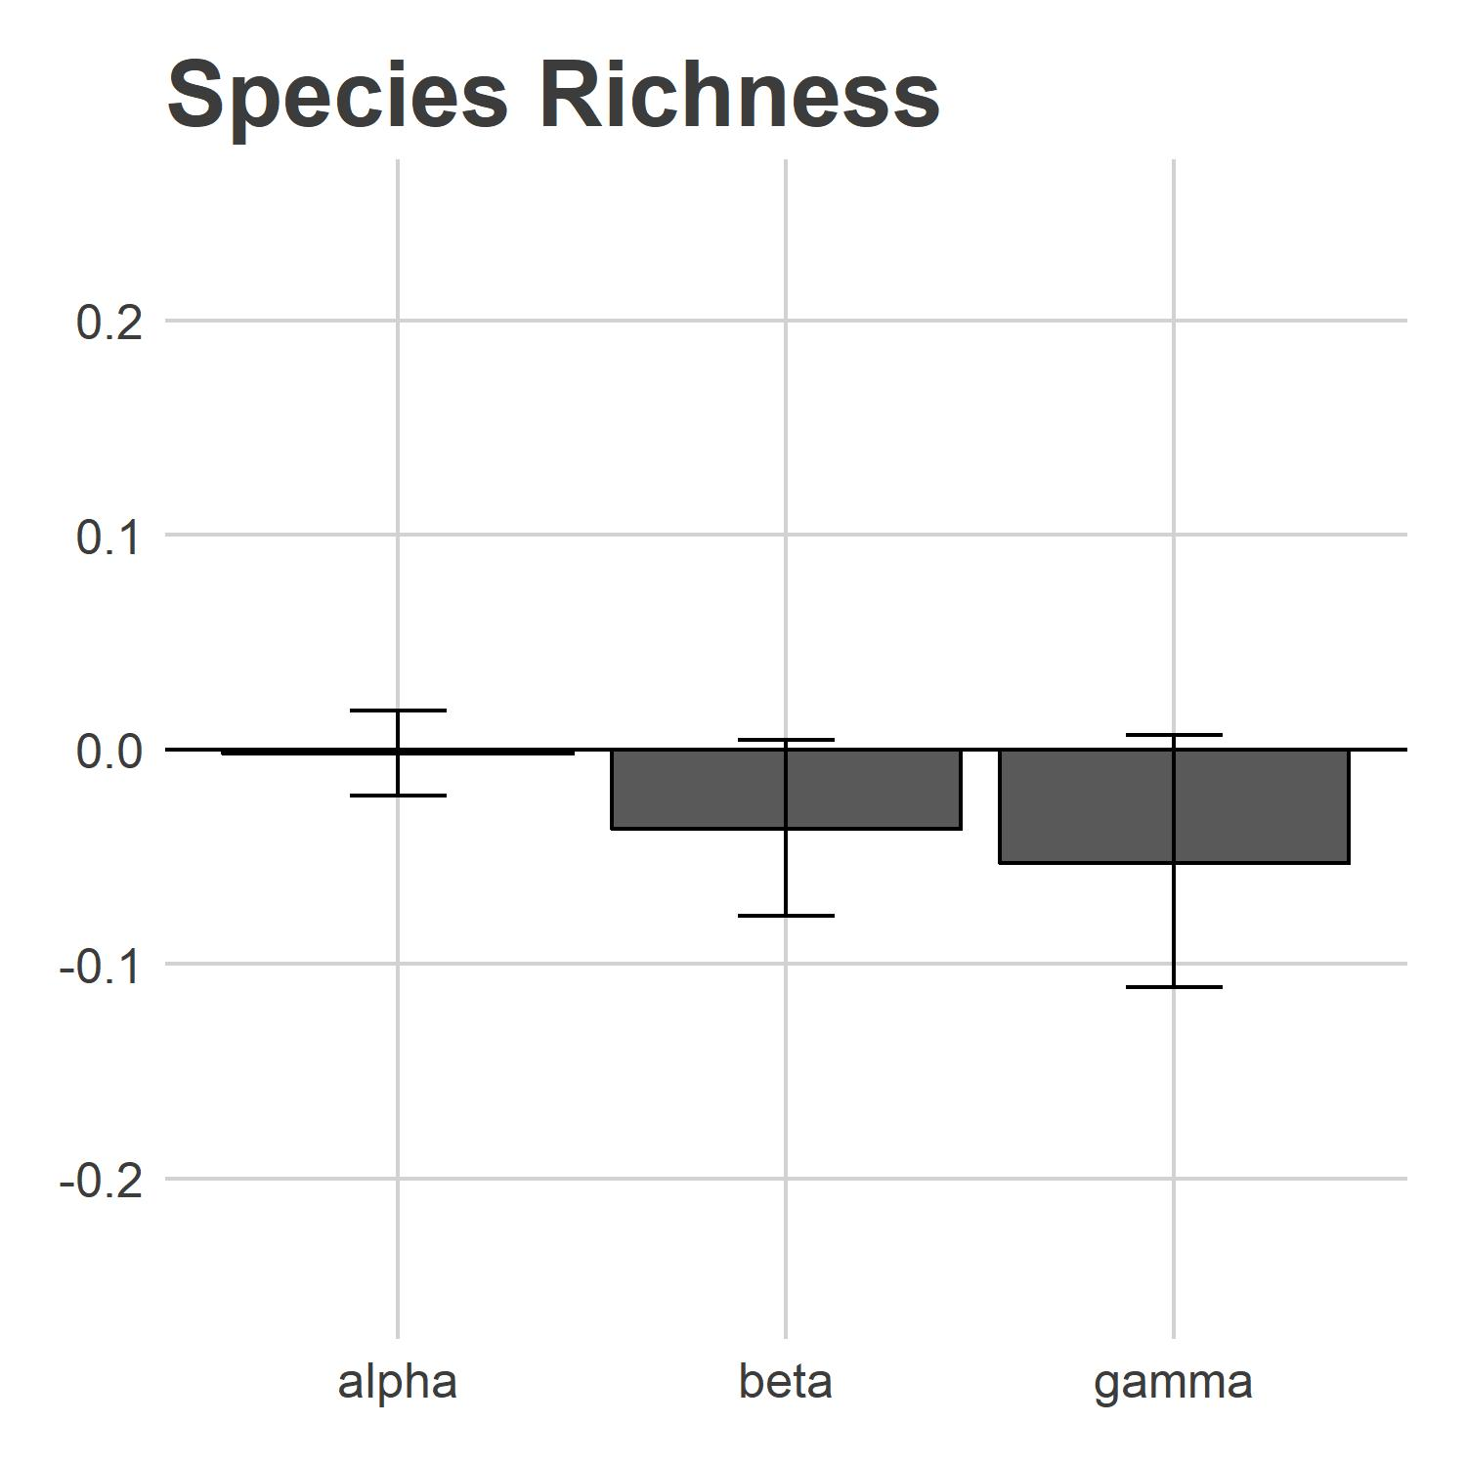
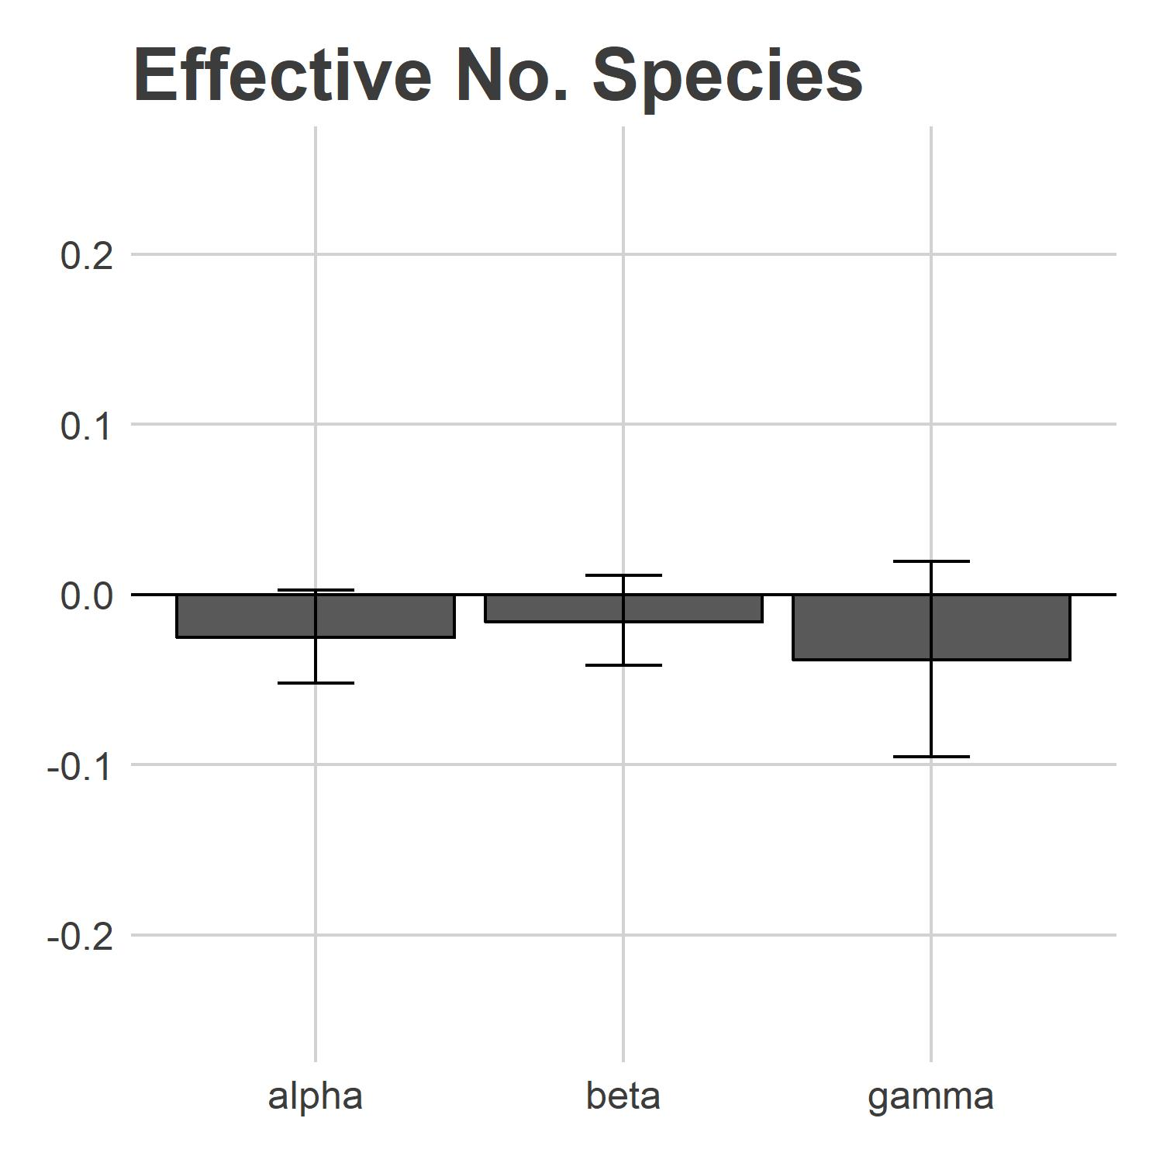
Diversity Change - 2017
Inverse Simpson Index
Proportion Diversity Change
Notes:
Despite this increase in light limitation, permutation-based tests of significance indicate that communities showed no significant change in either species richness, or abundance-weighted diversity. This is not surprising – California grasslands, as an annual system, are likely to take more than one year for nutrient enrichment to affect community assembly.

Slide 14
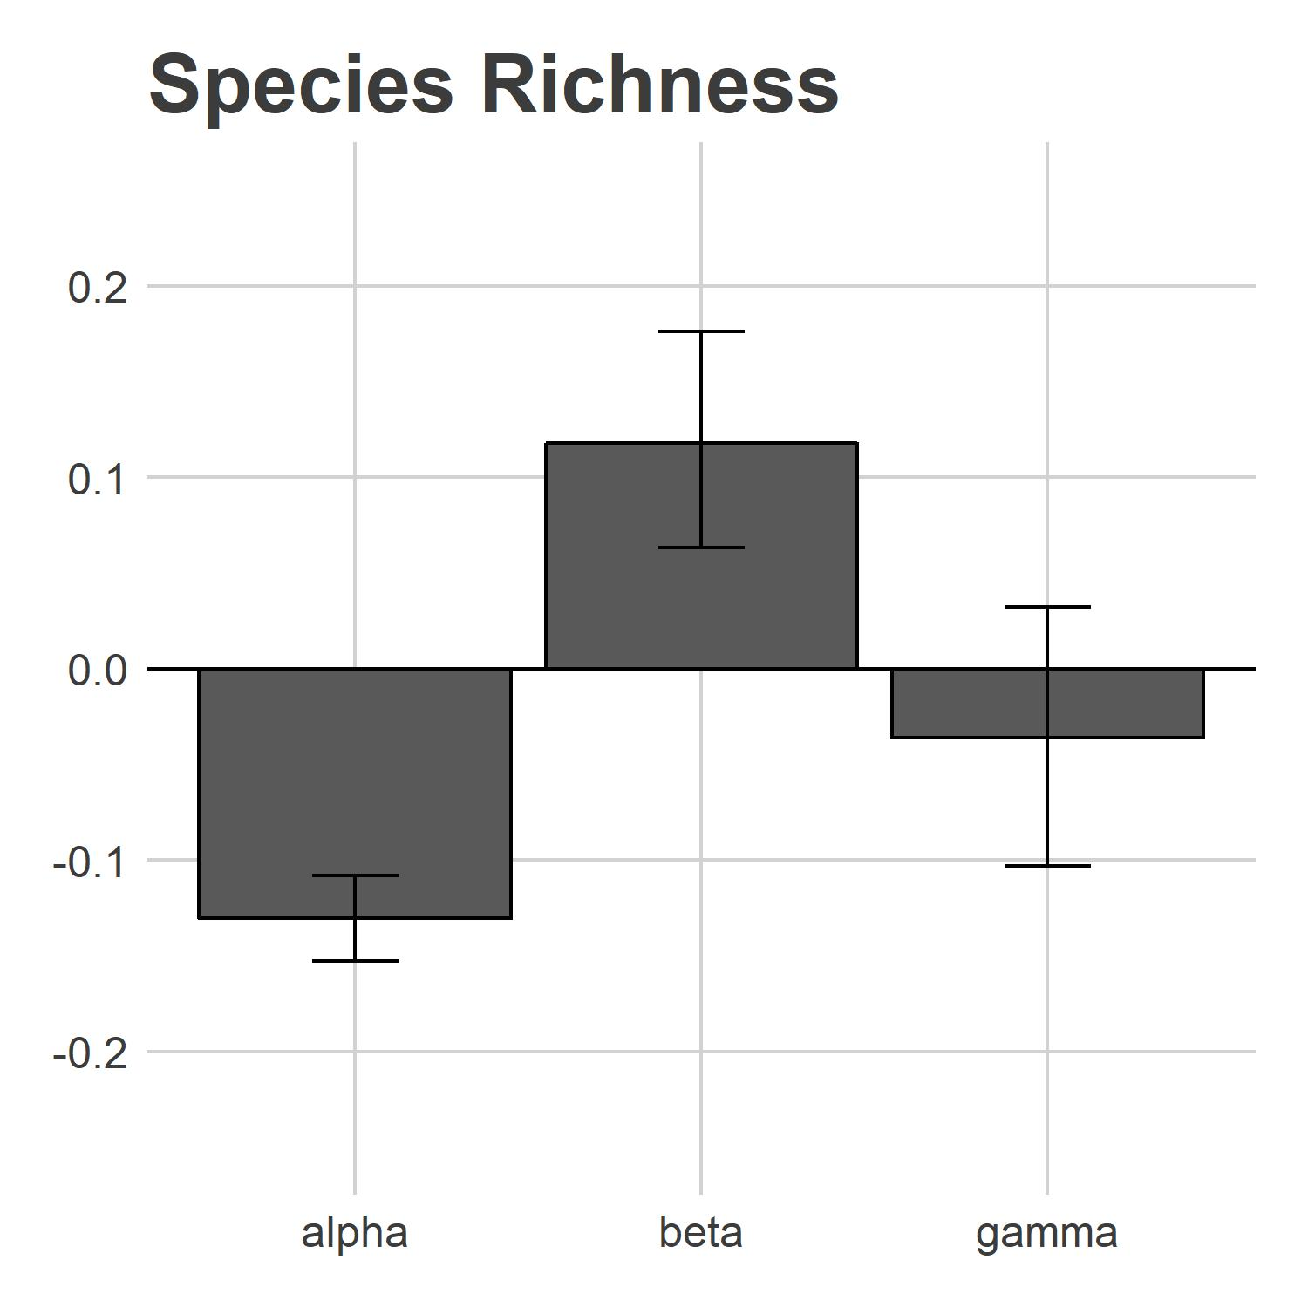
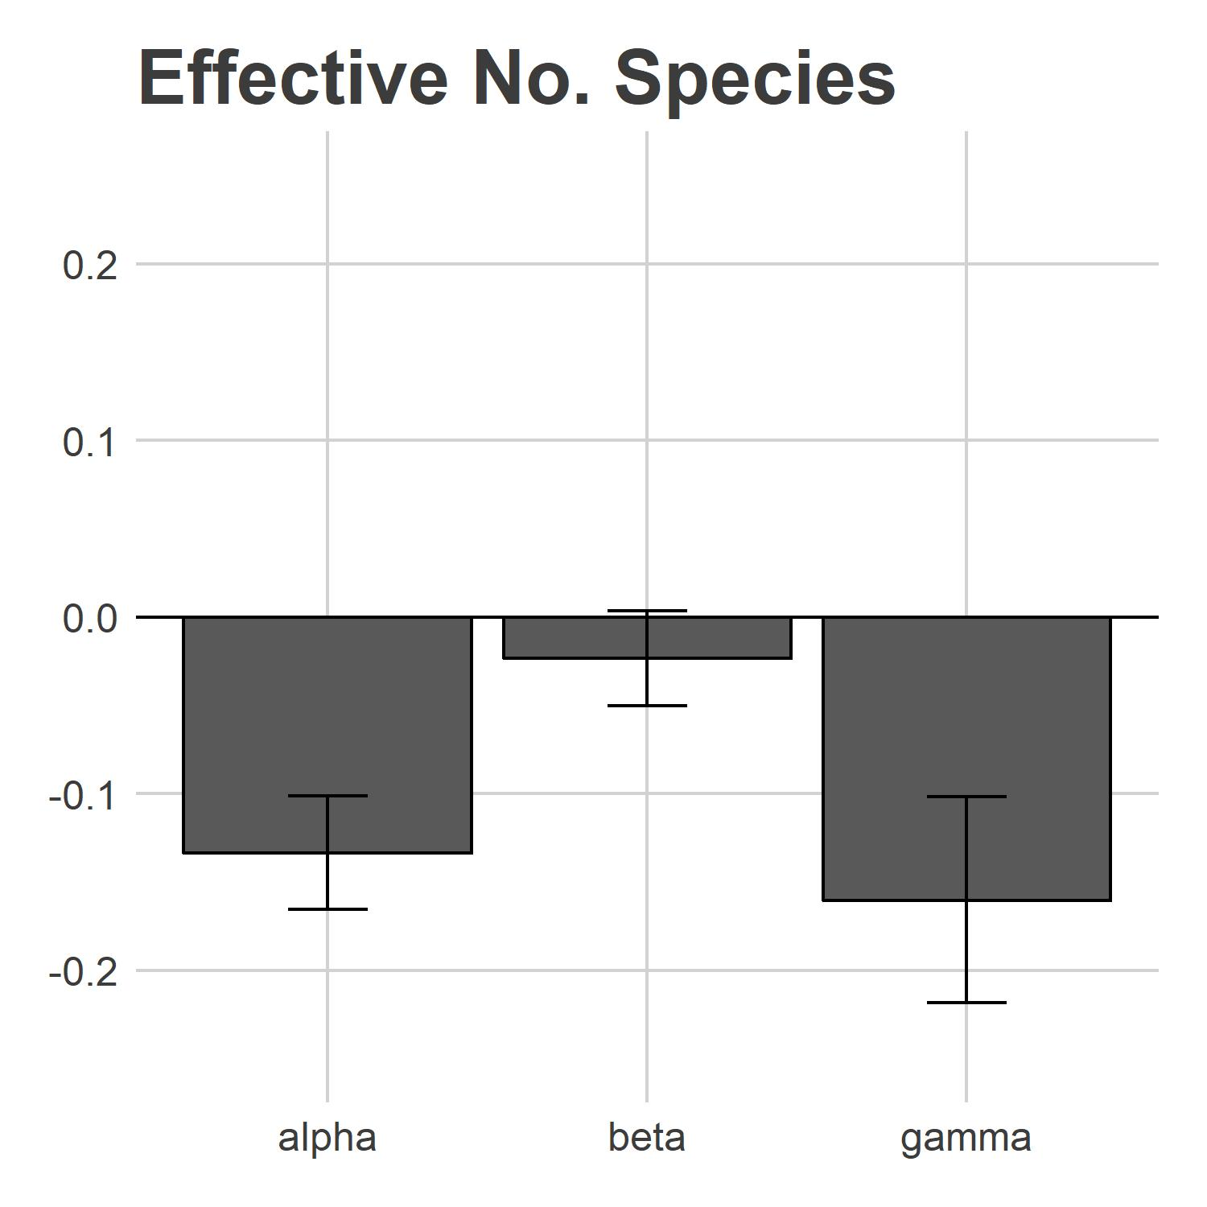
Diversity Change - 2018
Inverse Simpson Index
*
*
*
*
Proportion Diversity Change
Notes:
After two years of treatment, however, nutrient enrichment shows marked effects, though interpretation differs significantly depending on the choice of metric used.
When purely focused on species richness, comparison of alpha-beta-gamma relationships indicate that nitrogen enrichment results in a substantial decline in alpha-scale diversity, though did not appear to cause consistent reductions in the total number of species present within the entire spatial extent of sampling. This change corresponds with an interpreted increase in beta diversity – the turnover in species richness found within subsamples in each plot.
Incorporating abundance-weighted metrics into analysis, on the other hand, demonstrates declines in diversity that are consistent at both the individual sampling unit and whole plot scale, with no significant change in the turnover of these communities.

Slide 15
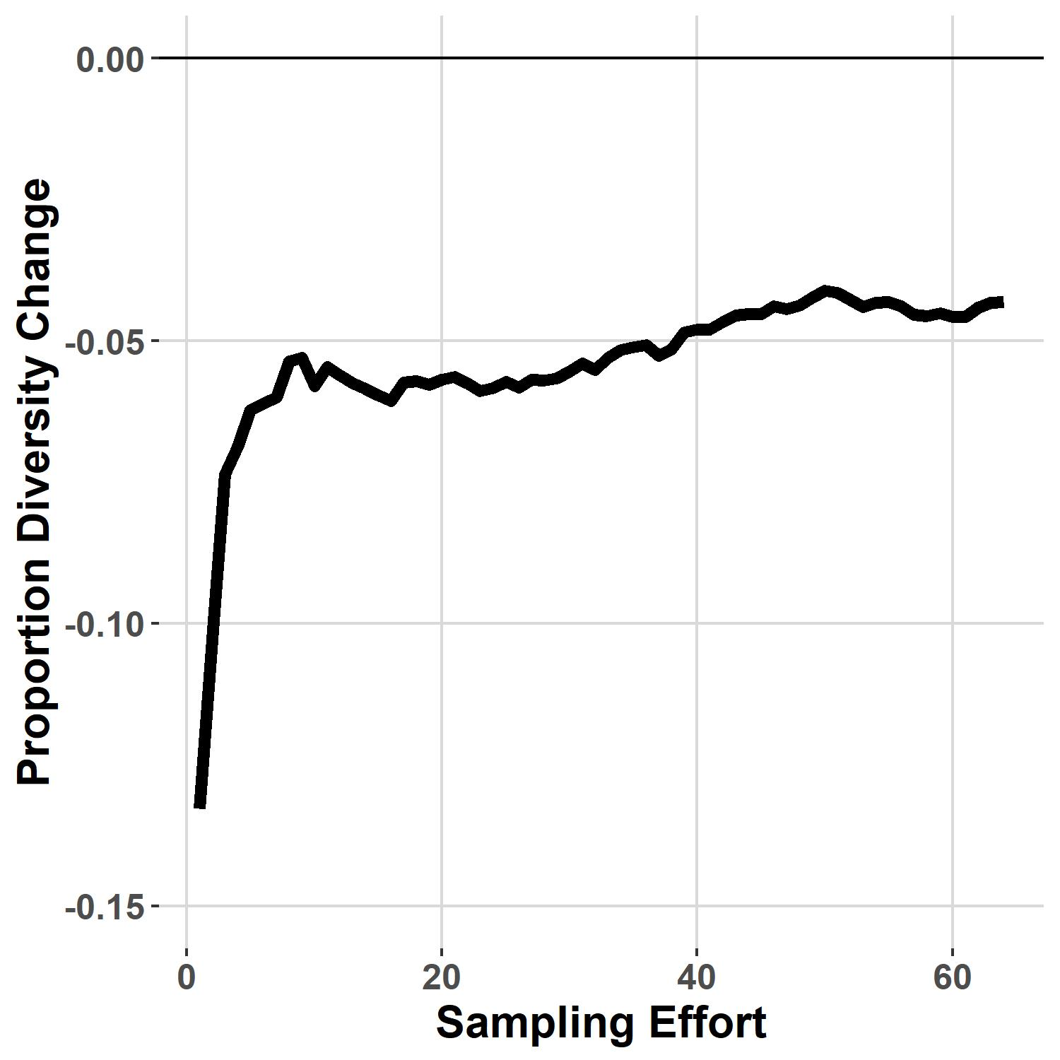
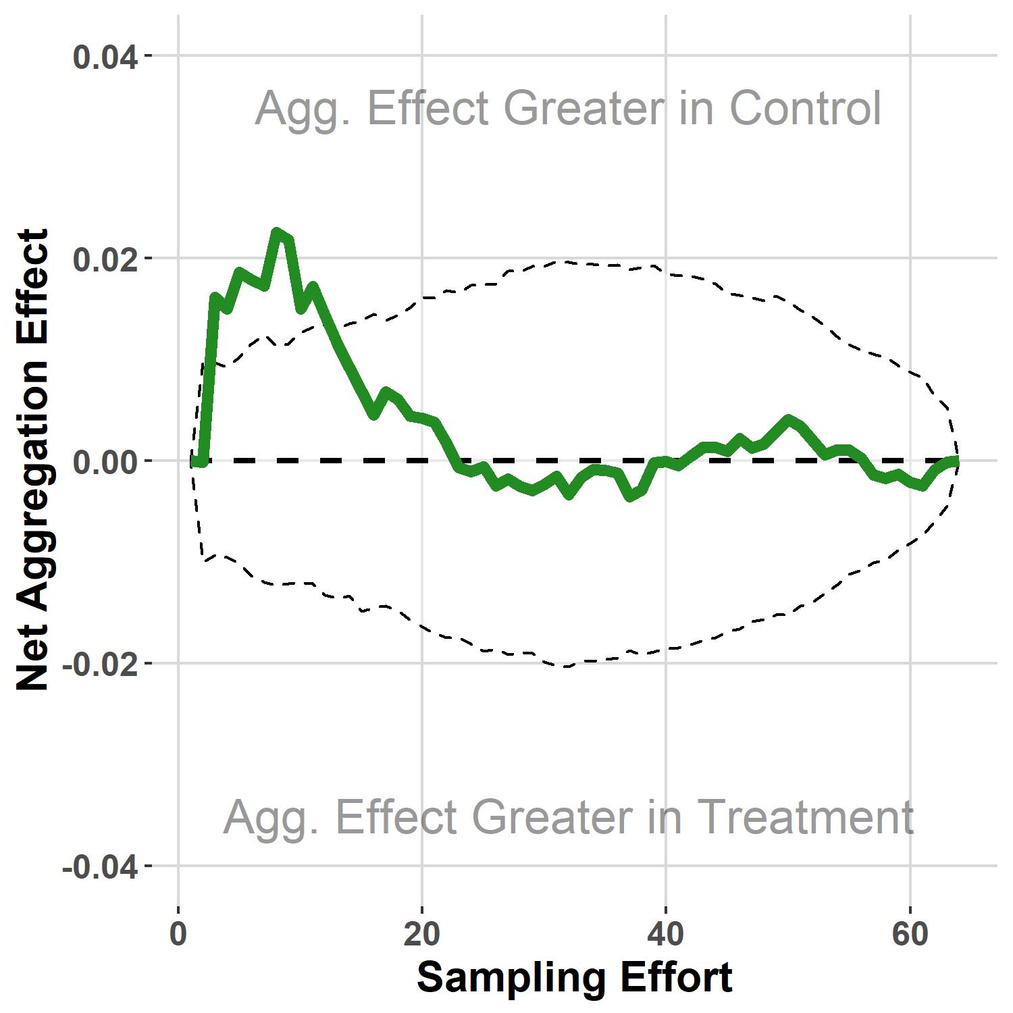
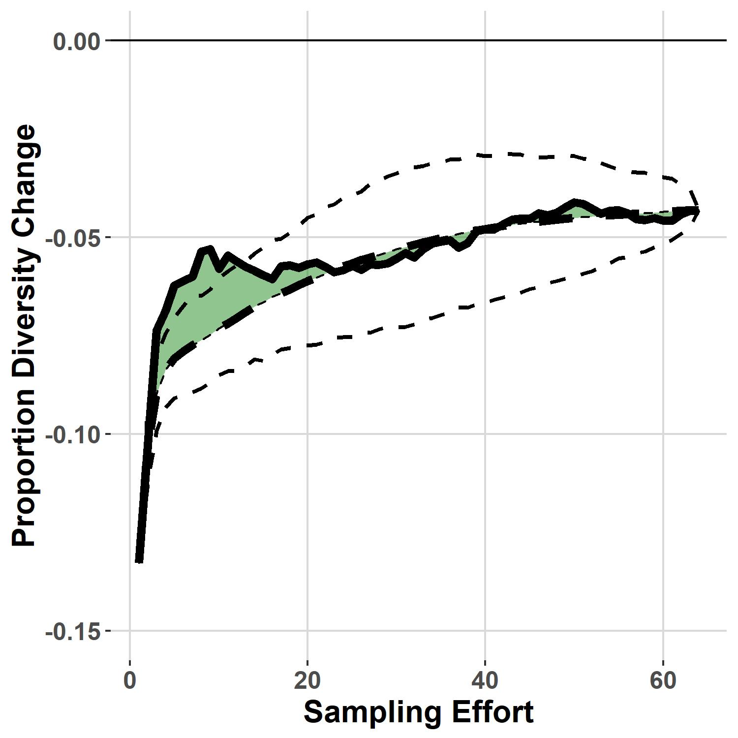
Accumulation Curve Decomposition
Species Richness
*
*
Notes:
Further decomposition of species richness change into its constituent accumulation curves indicates that response change with sampling effort was highly nonlinear – even small increases in sample accumulation dramatically reduced effects of nutrient enrichment.
When this spatial accumulation curve is compared to its random counterpart, we see a greater observed magnitude of diversity change when reducing the influence of spatial structure. This change suggests that our control communities exhibit a somewhat higher degree of spatial aggregation (clumping) at small sampling scales.

Slide 16
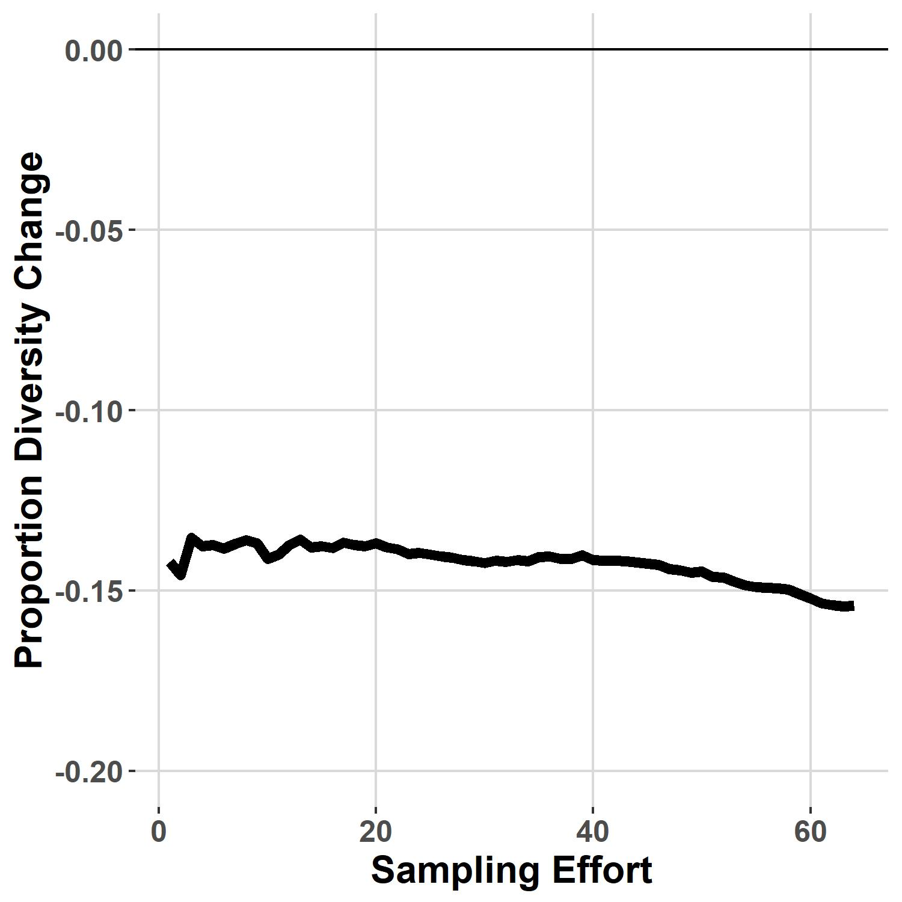
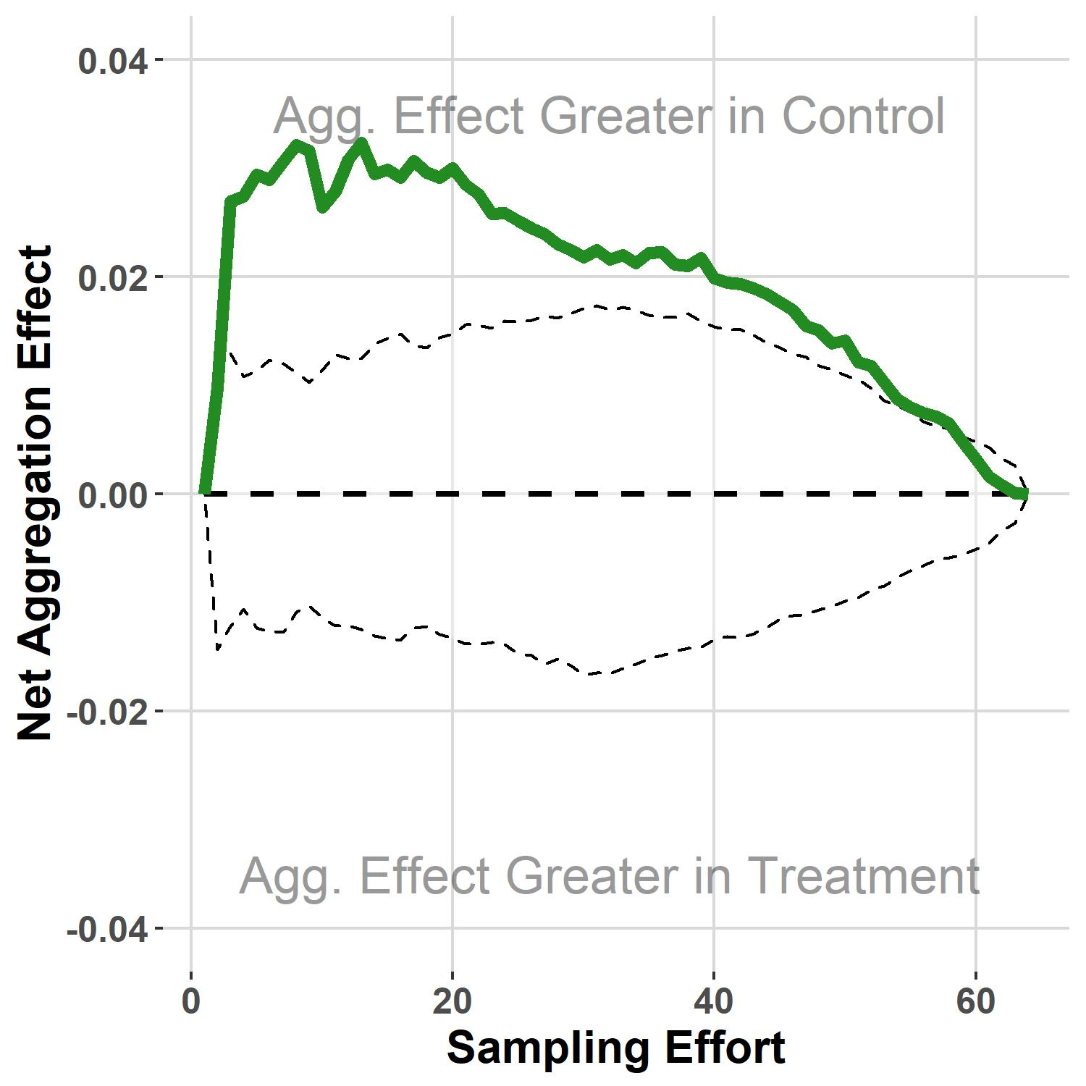
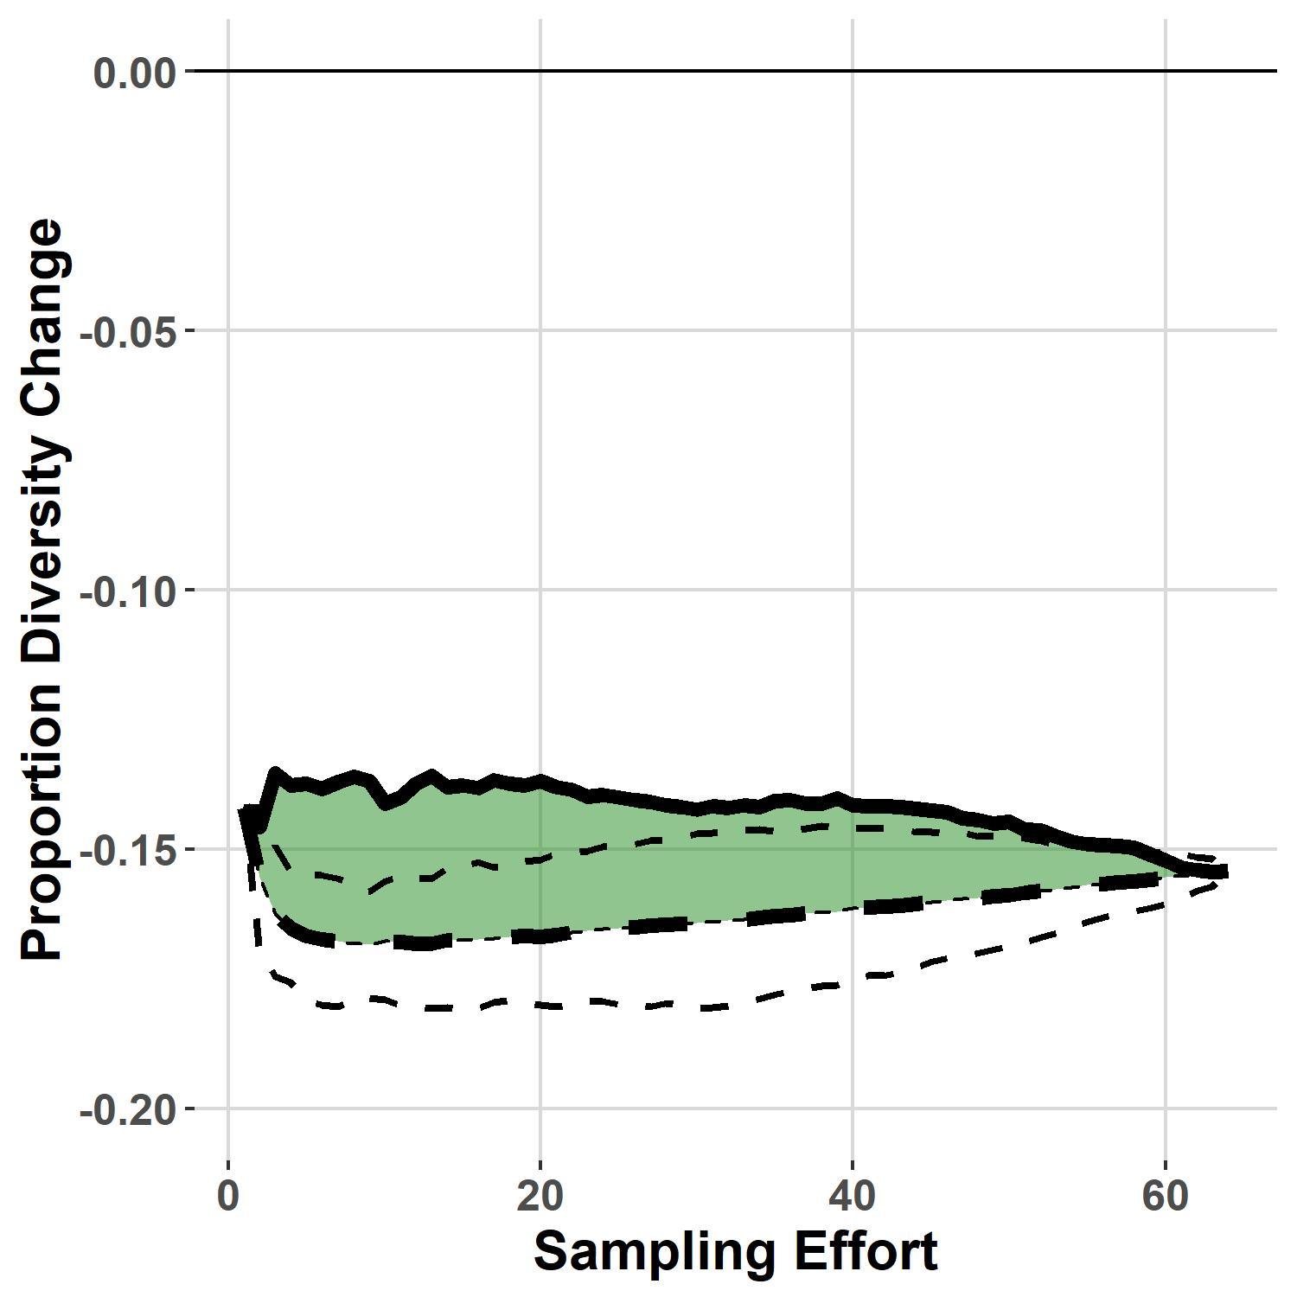
Accumulation Curve Decomposition
Inverse Simpson Index
*
*
Notes:
Use of abundance-weighted metrics to calculate diversity change effects indicates a far more linear response as a function of sampling effort – regardless of the number of samples taken, nutrient enrichment effects on the relative abundances of different species appears roughly consistent.
Moreover, the spatial aggregation effect in control treatments is far more pronounced when incorporating abundance into estimates of diversity change, and is detectable at far greater sampling efforts.

Slide 17
Conclusions
Scale-dependent effects of N enrichment depend on sampling metric used:
Nitrogen enrichment likely failed to cause
Nitrogen enrichment effects on relative abundance were more consistent across scales
Spatial homogenization in response to N enrichment
Reduction in spatial aggregation (clustering) of species, both in identity and abundance, in response to N addition.

Slide 18
Implications
Estimation of richness responses to N enrichment may translate poorly to broader spatial scales
Reduction in the relative abundance of rare species may greatly influence measurements of richness at small scales
Changes in relative abundance may be a more sensitive measure when extrapolating from experimental results
Changes to spatial pattern may produce effects on ecosystem function independent of biodiversity
Decreases in spatial aggregation may alter spatial coexistence mechanisms, storage effects, and response to disturbance

Slide 19
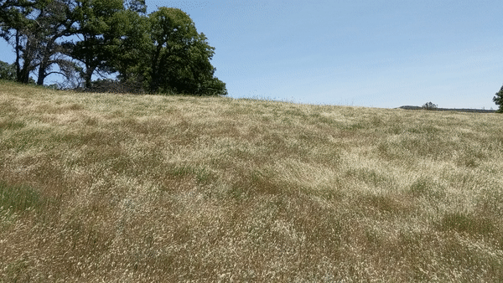


Acknowledgements
Funding Support:
UC Davis Plant Sciences Departmental Research Fellowship
UC Davis Jastro-Shields Research Fellowship
UC Davis Madson Award
University of California Natural Reserve System
Field and Laboratory Support:
Kaitlin Hanrahan, Nicholas Cahill, Sarah Gaffney, Julea Shaw, Catherine Koehler, Dustin Flavell, Chuck Vaughn; faculty and staff at McLaughlin Natural Reserve, Hopland REC, and Sierra Foothill REC.

Slide 20
Questions

Slide 21
